Slide 1
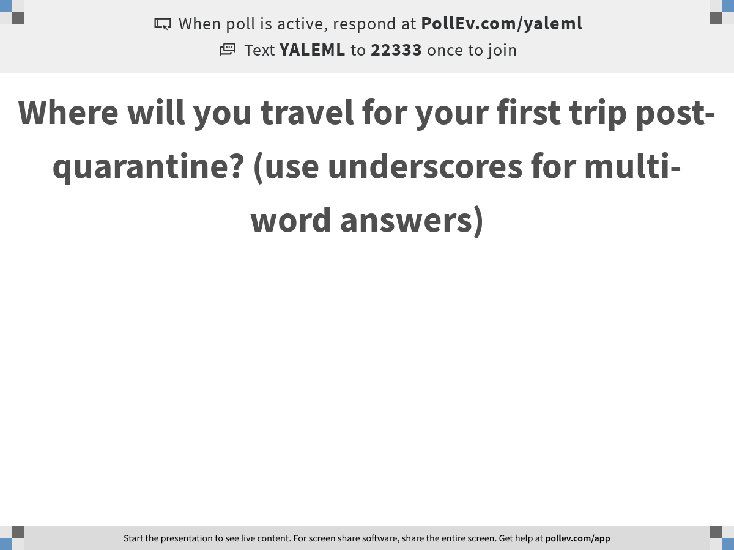
Notes:
Where will you travel for your first trip post-quarantine? (use underscores for multi-word answers)
https://www.polleverywhere.com/free_text_polls/qZtBAAQV0PIgu2RMVEYqS

Slide 2

Learning Clusters, Trajectories, and Gene Relationships from scRNA-seq data
Notes:
TA introduction
Talk about not teaching code (not a programming workshop)

Slide 3
How do clustering algorithms work?
Notes:
TA introduction
Talk about not teaching code (not a programming workshop)

Slide 4
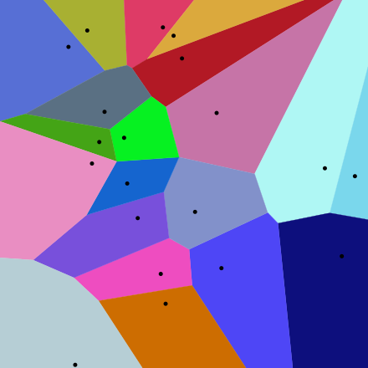
Clustering algorithms partition the data space
Dim. 2
Dimension 1
K-MEANS (Macloed 1967), Fidduccia Matheyses
Voronoi Diagram

Slide 5
How is the partition picked?
By minimizing different objective criteria
Closeness of members within the group
Distance/Separation between groups
Ratio of the two
Minimum cut of an NN-graph
Other criteria?
Modularity: actual edges/ expected edges

Slide 6
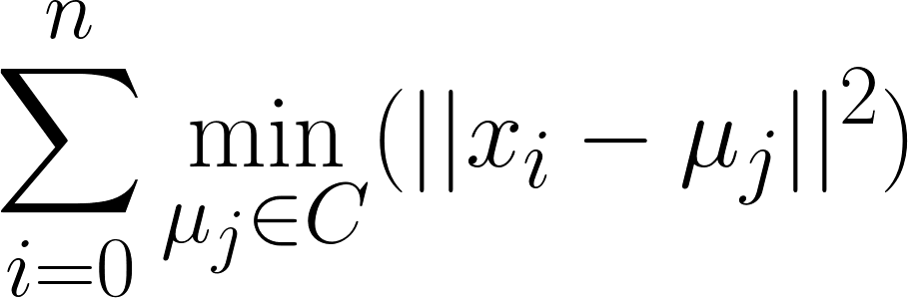
Mean Squared Error
Given data
Partition into k clusters
Such that the within-cluster variance is minimized
“The sum of all squared euclidean distances between each point and that point’s closest cluster mean”

Slide 7
K-Means Clustering
Randomly partition data into k clusters
Update step: Compute the means of clusters
Assignment step: Reassign each x_{i} to cluster S_{j} that has the nearest mean u_{j}
Nearest mean minimizes squared Euclidean distance

Slide 8
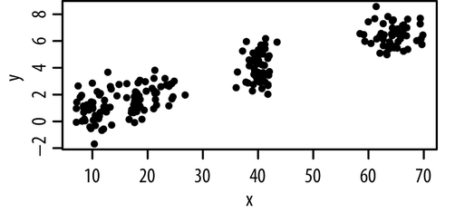
k-Means minimizes within-cluster sum-of-squares
Unlabelled data

Slide 9
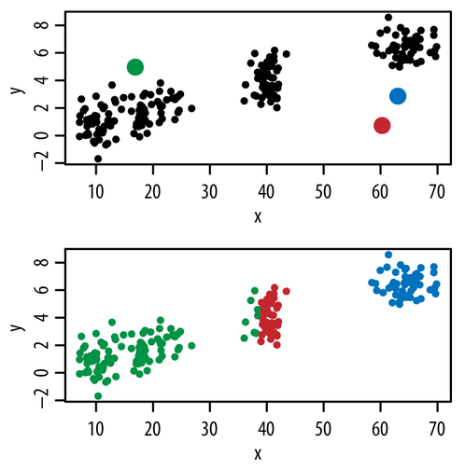
k-Means minimizes within-cluster sum-of-squares
centroid
Random initialization
Assign points to nearest centroid

Slide 10
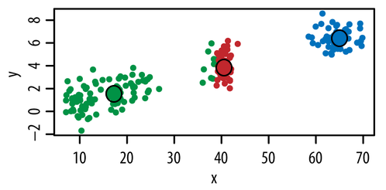
k-Means minimizes within-cluster sum-of-squares
Repeat until convergence
Assign points to nearest centroid
Move centroids to middle of cluster
2.
3.

Slide 11
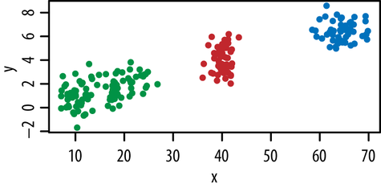
k-Means minimizes within-cluster sum-of-squares
Repeat until convergence
Move centroids to middle of cluster
Assign points to nearest centroid
3.
4.

Slide 12
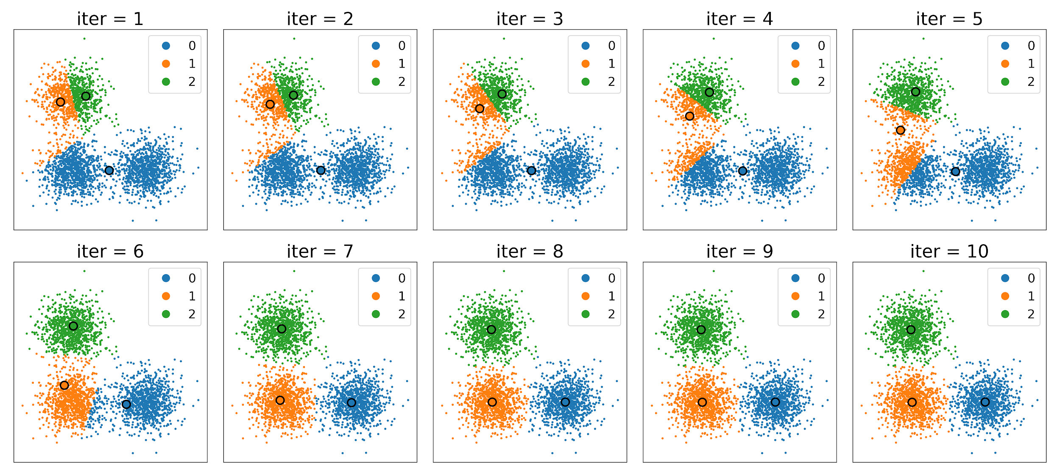
10 iterations of KMeans on Gaussians

Slide 13
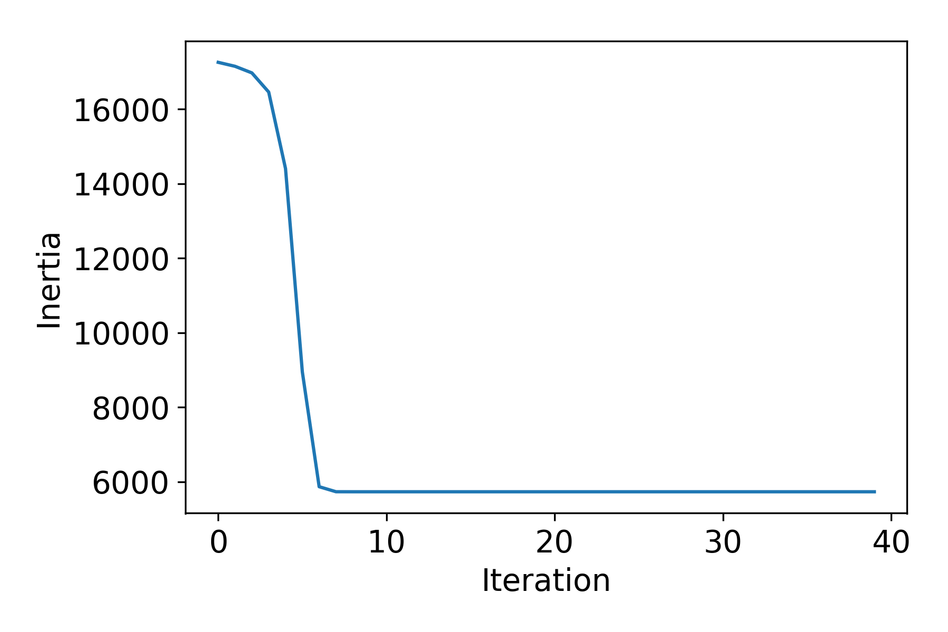
What does convergence look like?
within-cluster sum-of-squares
Inertia =
=
convergence

Slide 14
What does it converge to?
Generally a local minima.
Sensitive to initial conditions
Methods for initialization:
Forgy: K observations chosen as means
Random Partition: Randomly partitions data

Slide 15
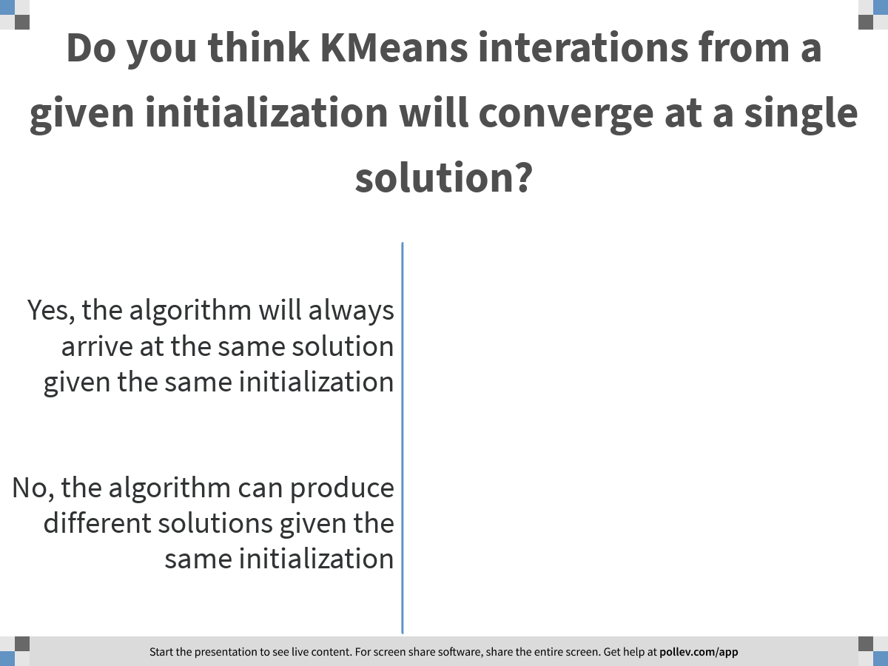
Notes:
Do you think KMeans interations from a given initialization will converge at a single solution?
https://www.polleverywhere.com/multiple_choice_polls/zUnXsAnl2jlUJAHMGDLt6

Slide 16
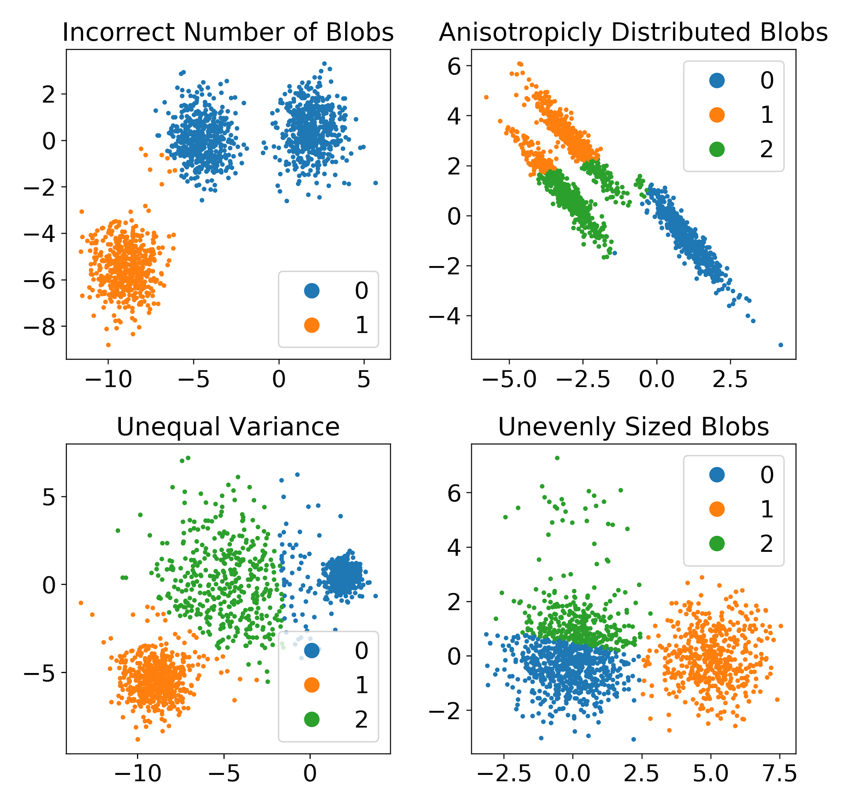
“K-means clustering is not a free lunch”
k-Means assumes:
K is chosen correctly
The data is distributed normally around the mean
All clusters have equal variance
All clusters have the same number of points
K-Means is sensitive to:
Initialization
Outliers
http://varianceexplained.org/r/kmeans-free-lunch/ https://scikit-learn.org/stable/auto_examples/cluster/plot_kmeans_assumptions.html

Slide 17
Limitations of this method
Assumes a shape for the cluster: spectral clustering can help with this
Must give number of clusters: there are methods to choose the number of clusters
Sensitive to outliers: k-mediods helps with this
Finds a local minima: repeat with different initializations

Slide 18
“K-means clustering is not a free lunch”
k-Means assumes:
K is chosen correctly
The data is distributed normally around the mean
All clusters have equal variance
All clusters have the same number of points
http://varianceexplained.org/r/kmeans-free-lunch/ https://scikit-learn.org/stable/auto_examples/cluster/plot_kmeans_assumptions.html

Slide 19
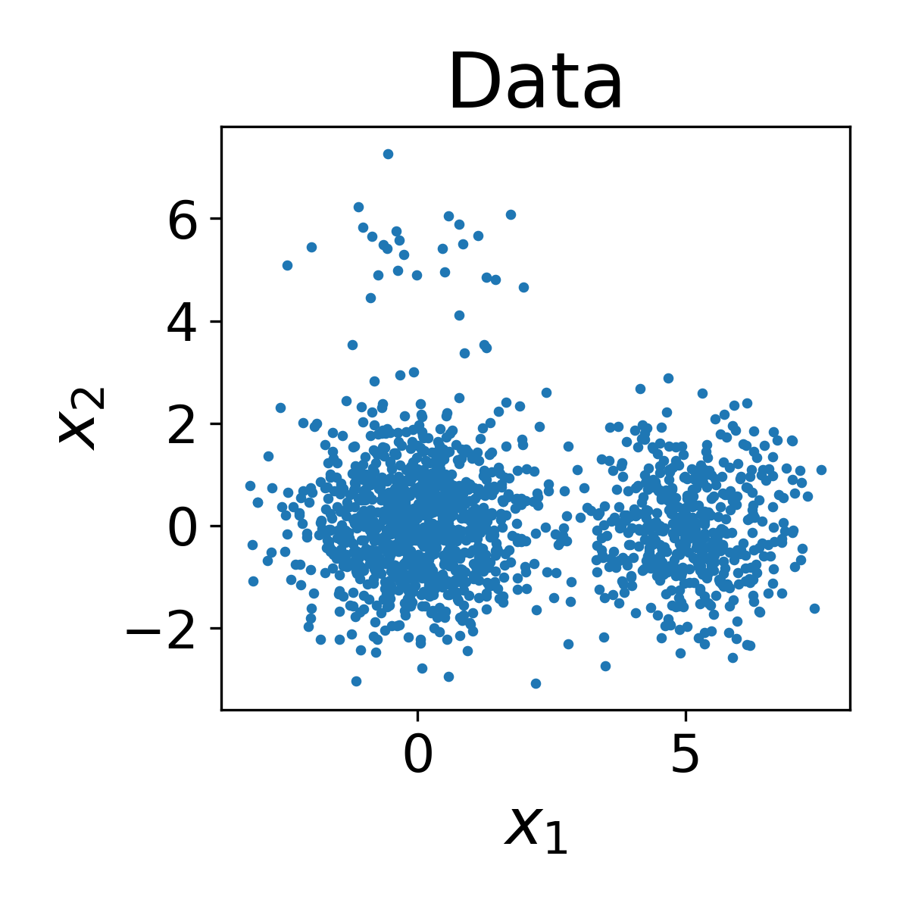
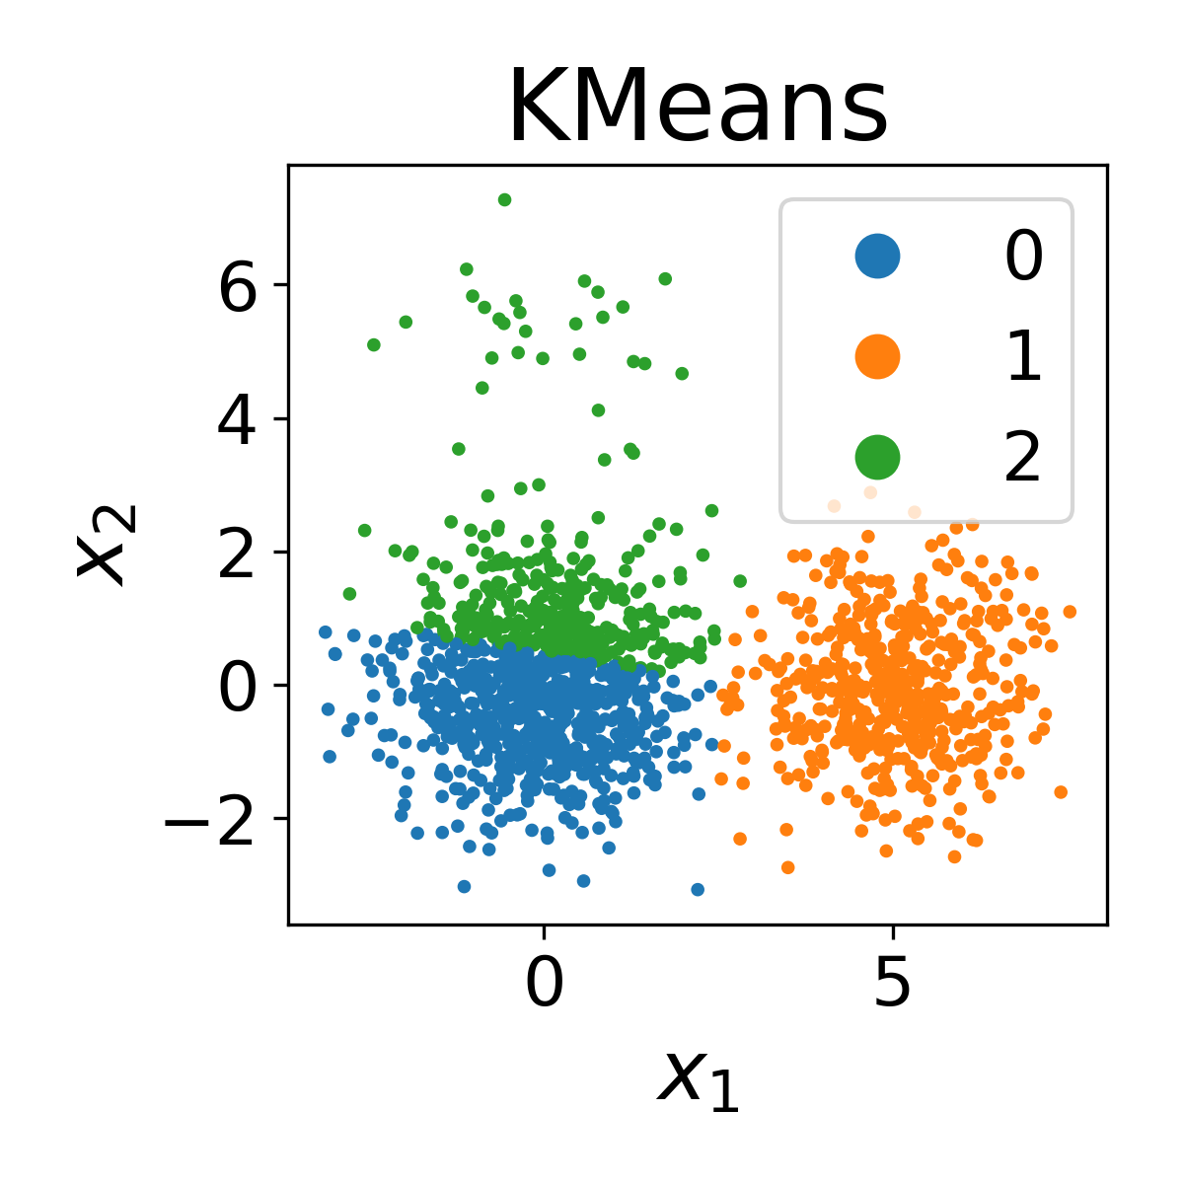
What happens when the kMeans assumptions are violated?

Slide 20
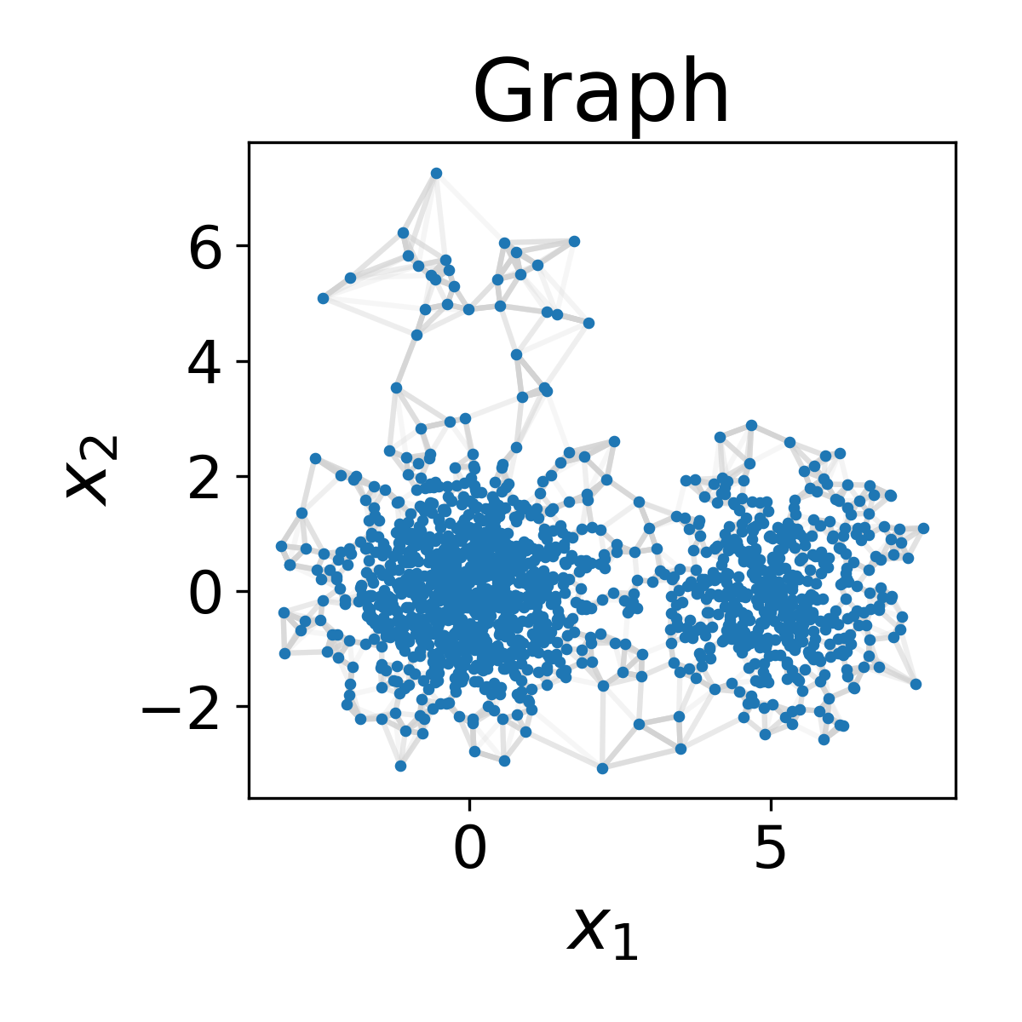
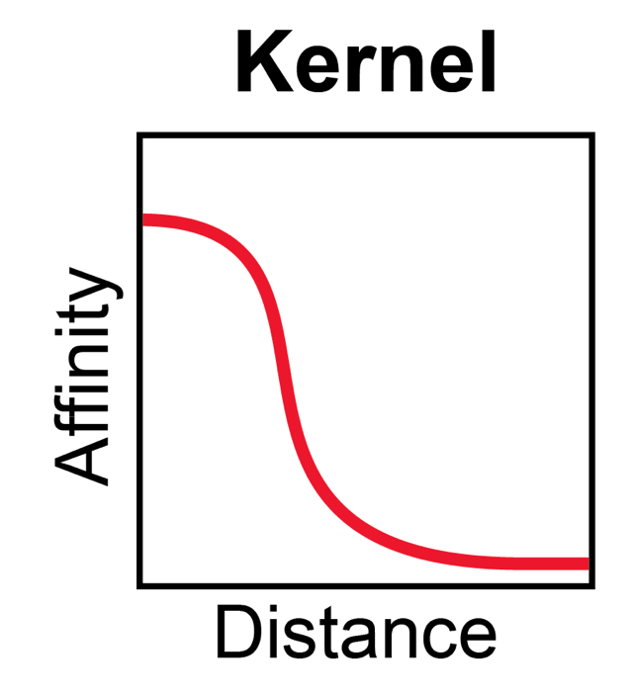
Spectral clustering uses eigenvectors of the graph Laplacian for clustering

Slide 21

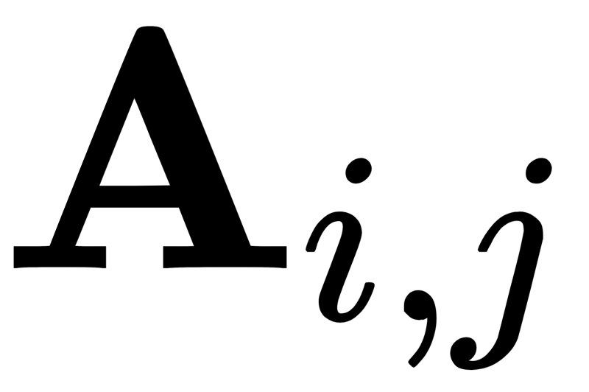
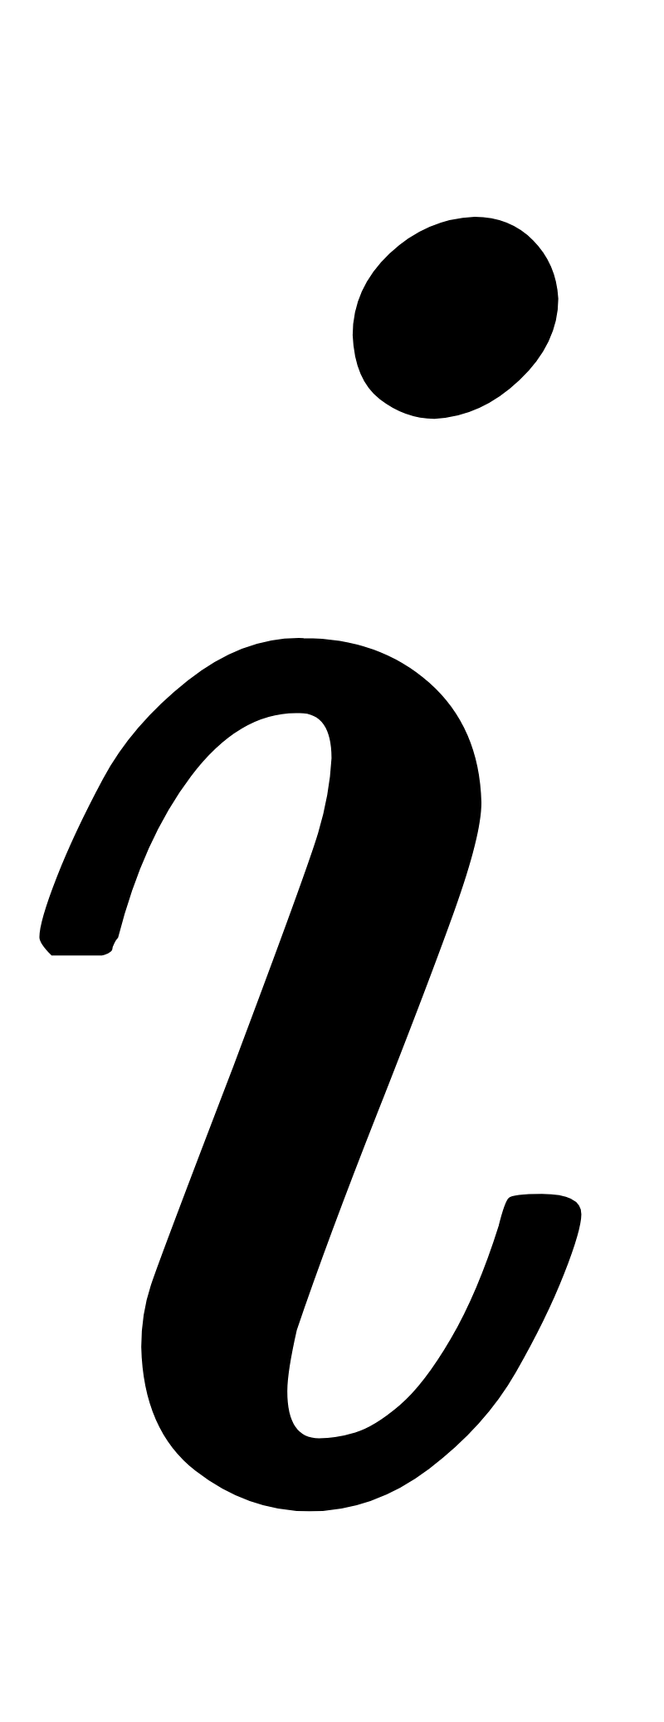


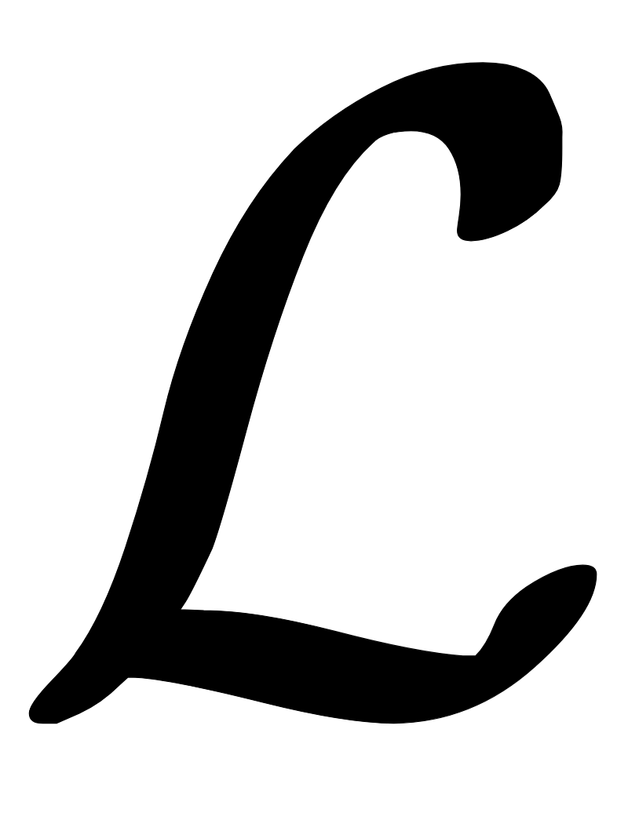

Spectral clustering uses eigenvectors of the graph Laplacian for clustering
= adjacency matrix
= edge weight between nodes and
= degree matrix
= Laplacian matrix =

Slide 22
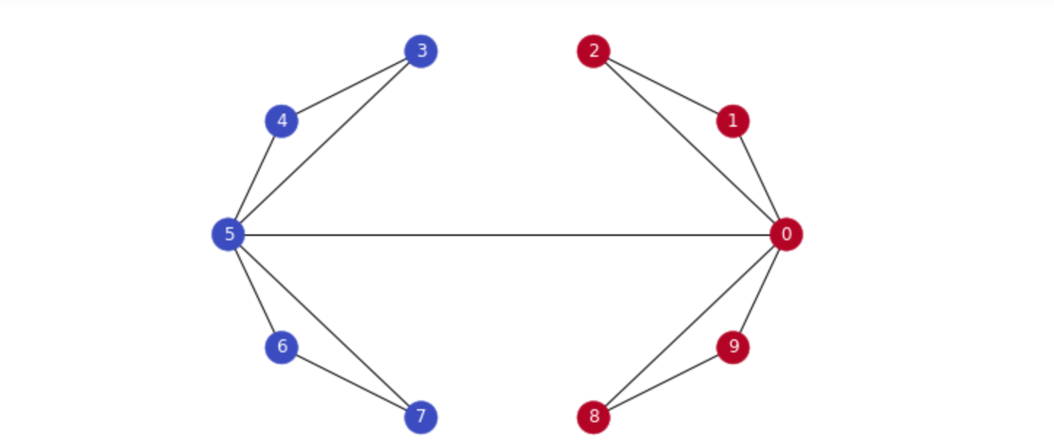
Fiedler Vector
Second-smallest Eigenvalue is called Fiedler value, corresponding vector is the Fiedler vector
Fiedler value := approximates minimum cut needed to partition graph
Value if graph was already in two components?
Vector can be used for partitioning, positive in one partition, negative in another

Slide 23
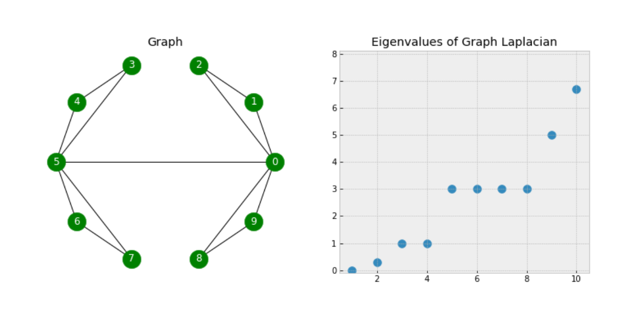
GAP
There is a gap between 4th and 5th values, increases suddenly, indicates that
there are 4 clusters in the graph roughly.

Slide 24
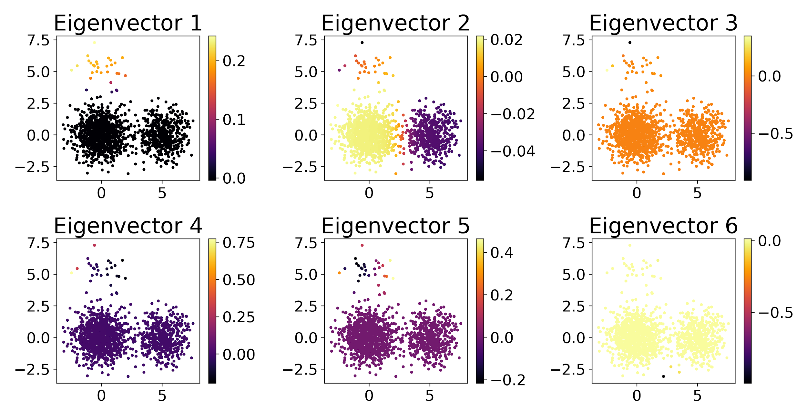
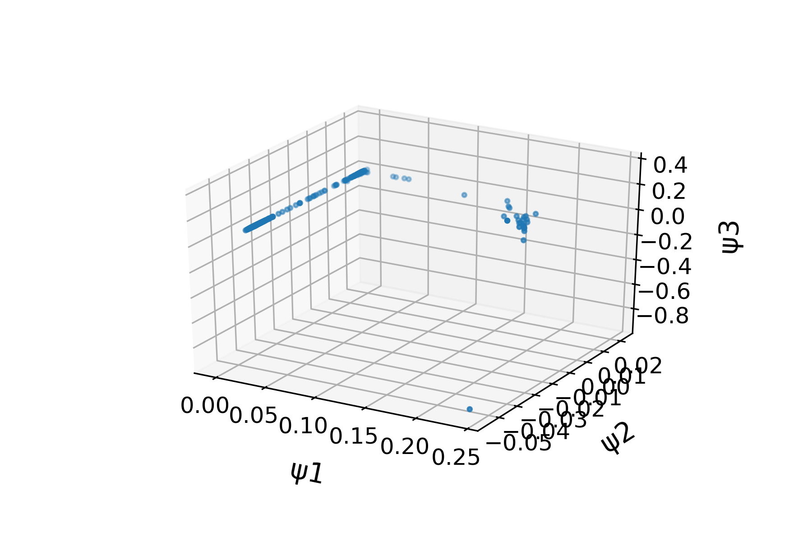
Spectral clustering uses eigenvectors of the graph Laplacian for clustering

Slide 25
Spectral clustering uses eigenvectors of the graph Laplacian for clustering

Slide 26
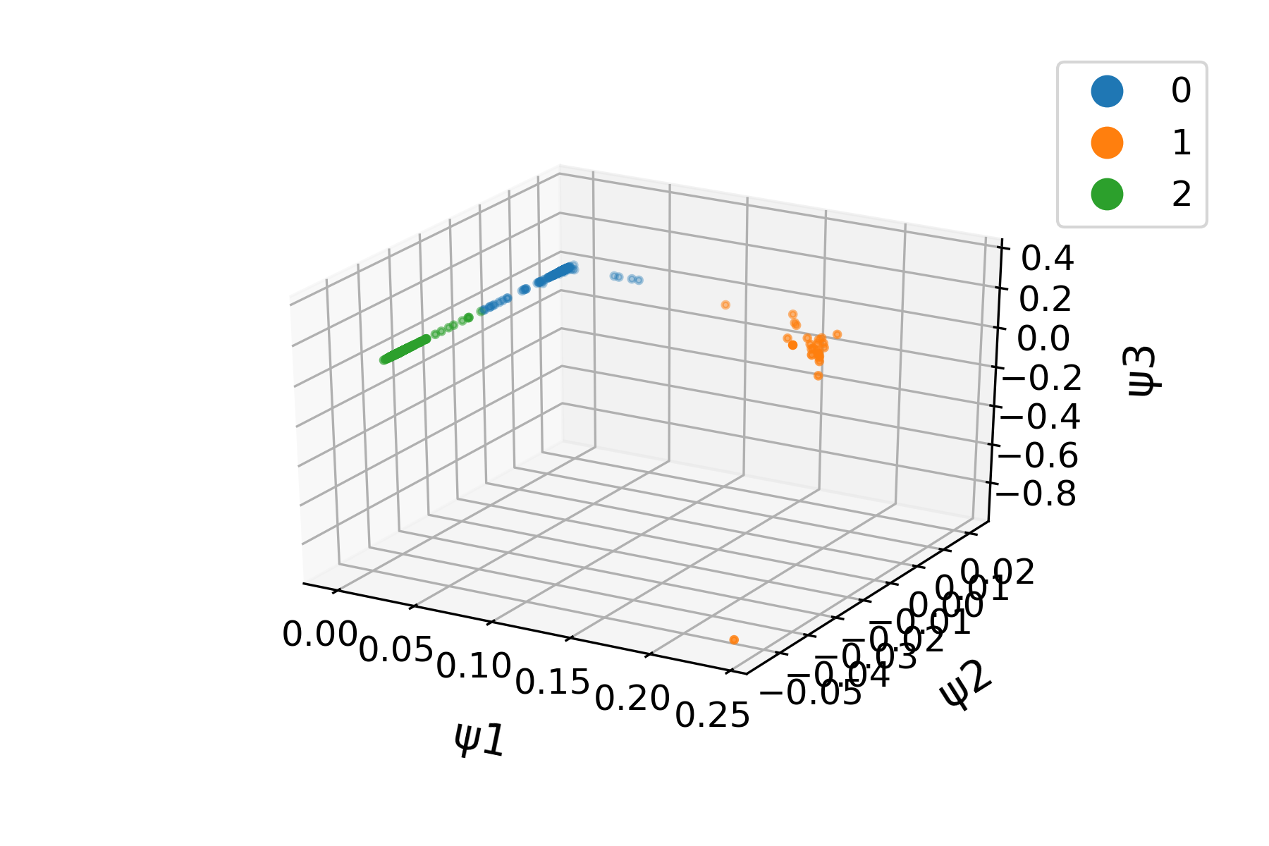
Spectral clustering uses eigenvectors of the graph Laplacian for clustering
KMeans

Slide 27
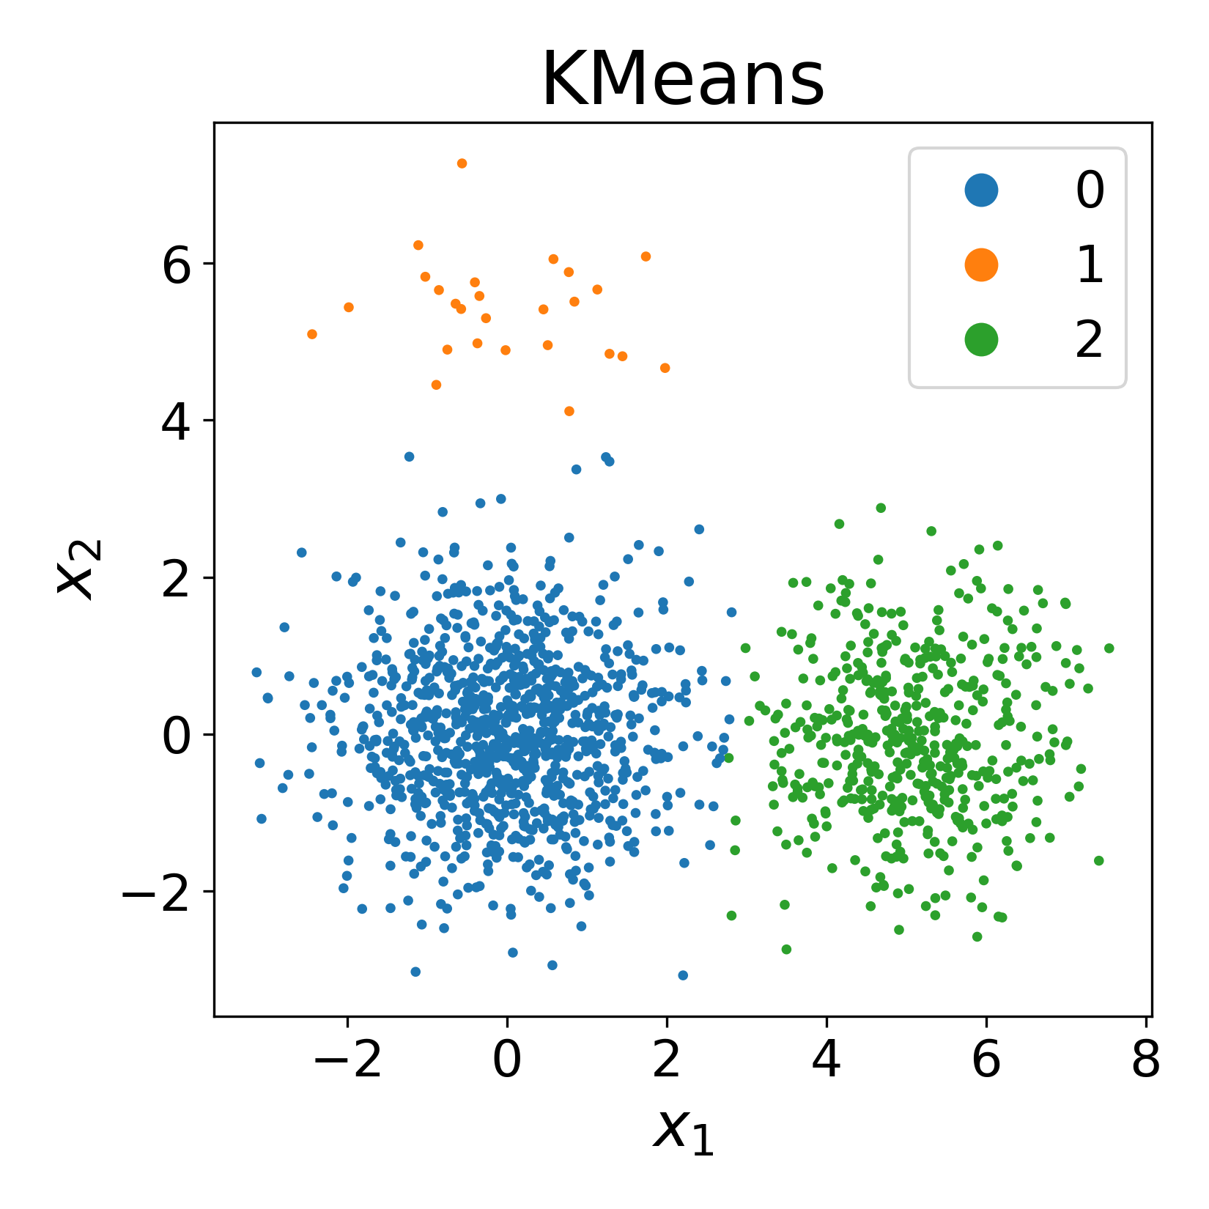
Spectral clustering uses eigenvectors of the graph Laplacian for clustering
Spectral
KMeans

Slide 28
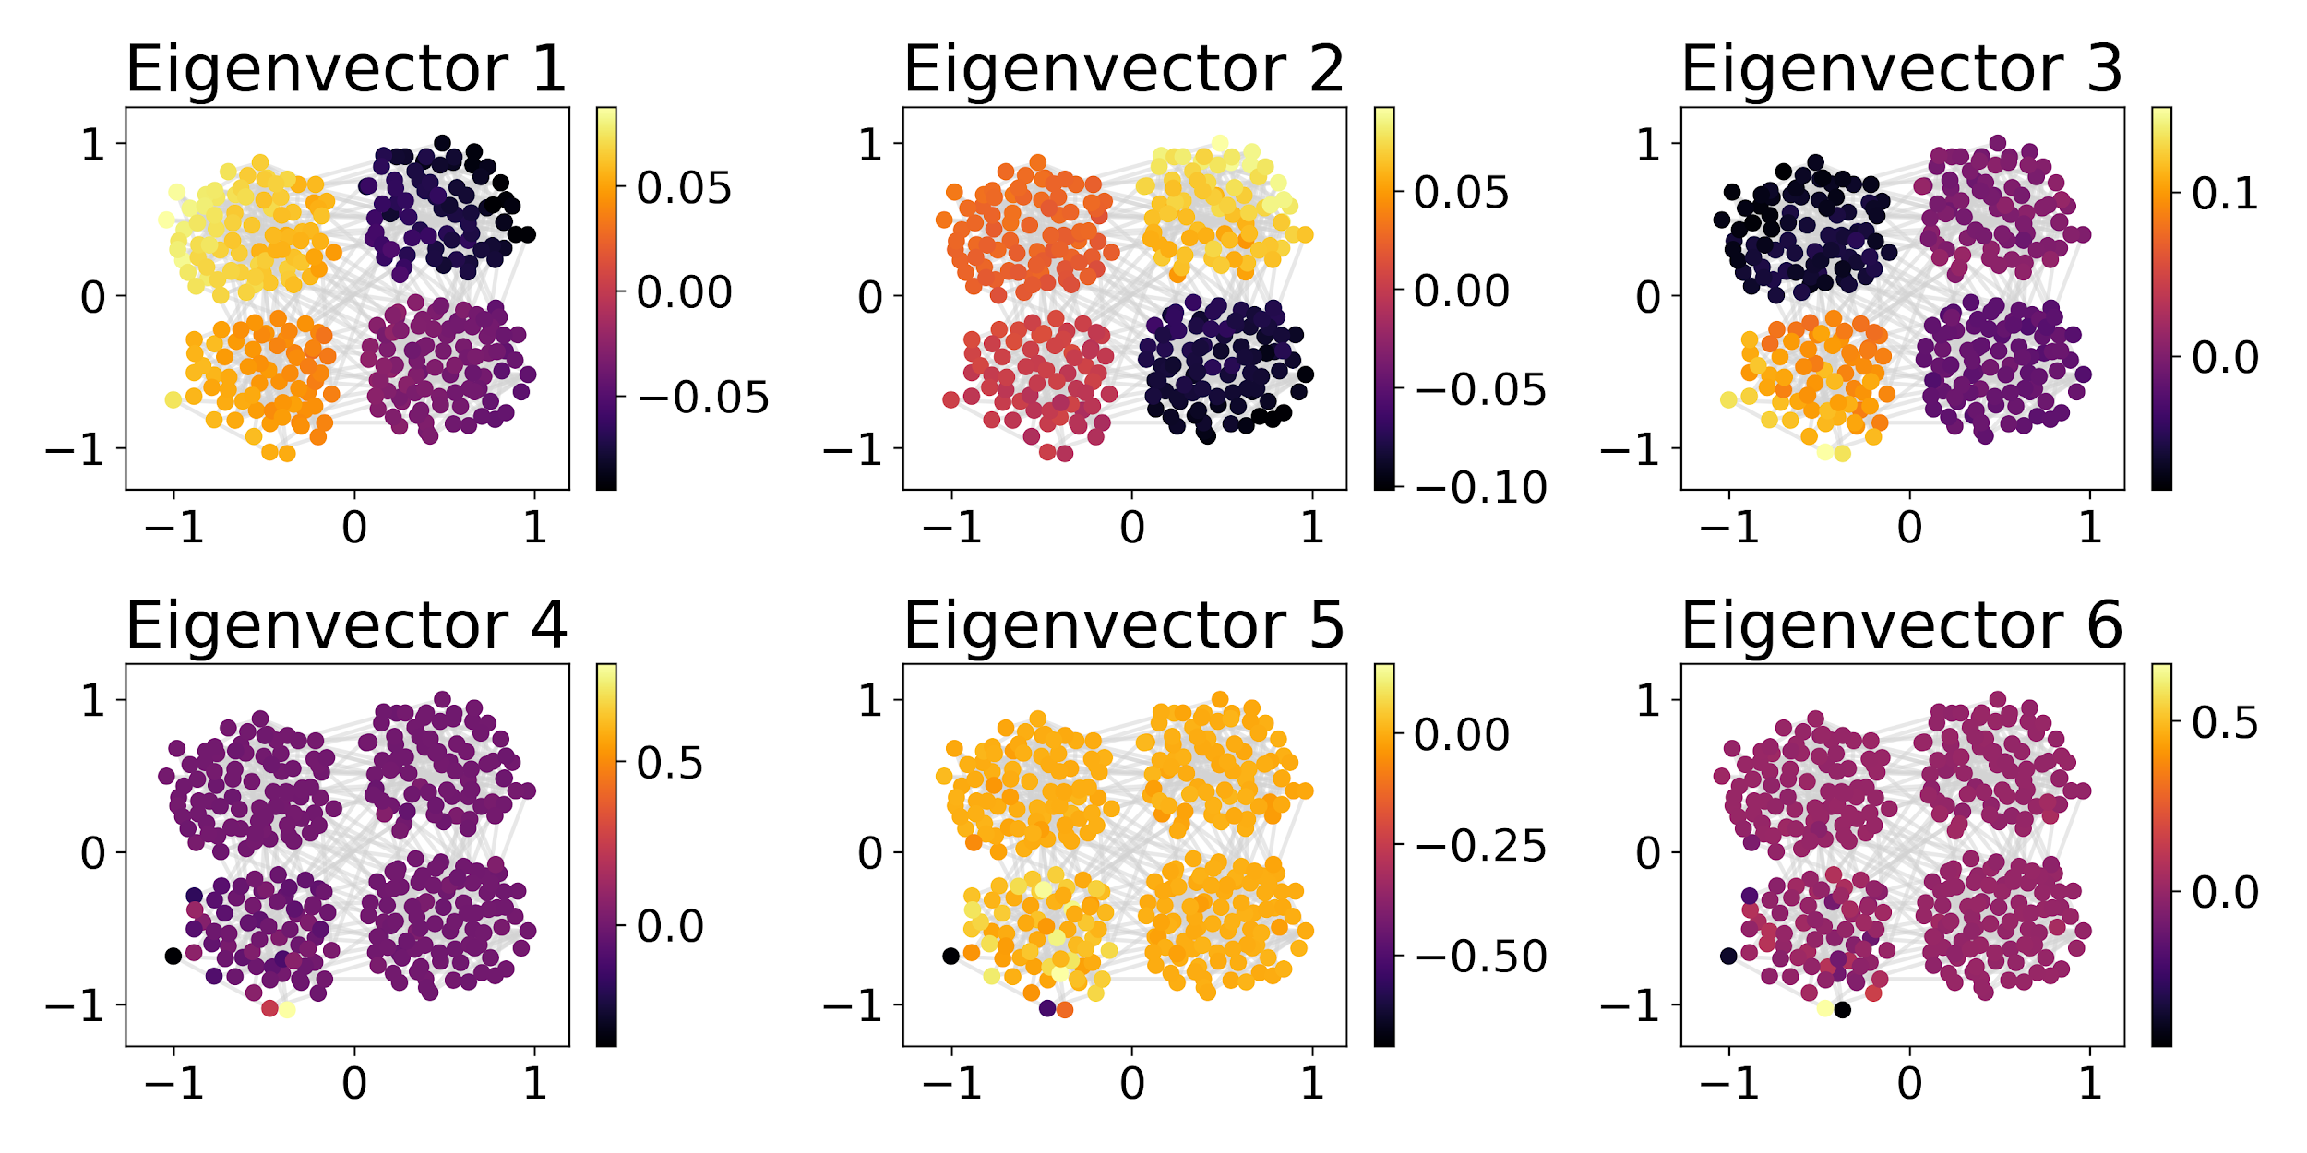
Spectra of various graphs

Slide 29
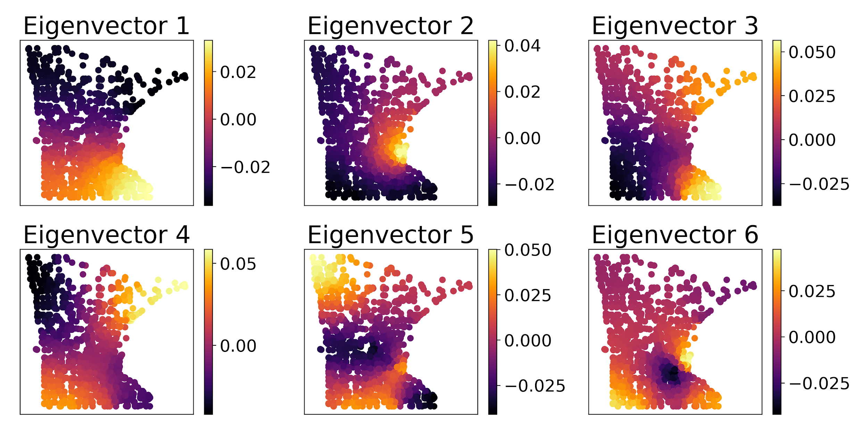
Spectra of various graphs

Slide 30
What are advantages of using the graph spectrum for k-Means?

Slide 31
What are advantages of using the graph spectrum for k-Means?
Good for clusters of arbitrary shape
Good for data that is just a graph
Only need connectivity information!

Slide 32
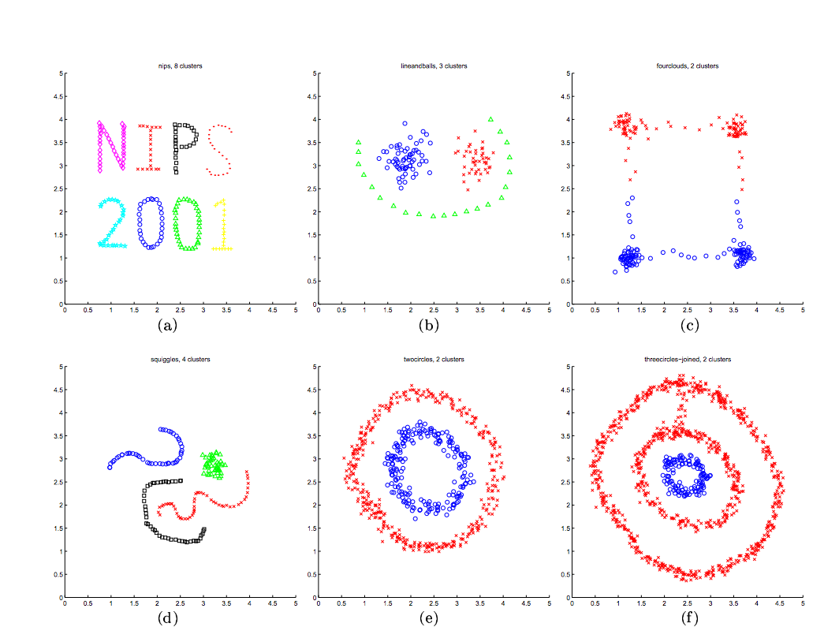

Slide 33
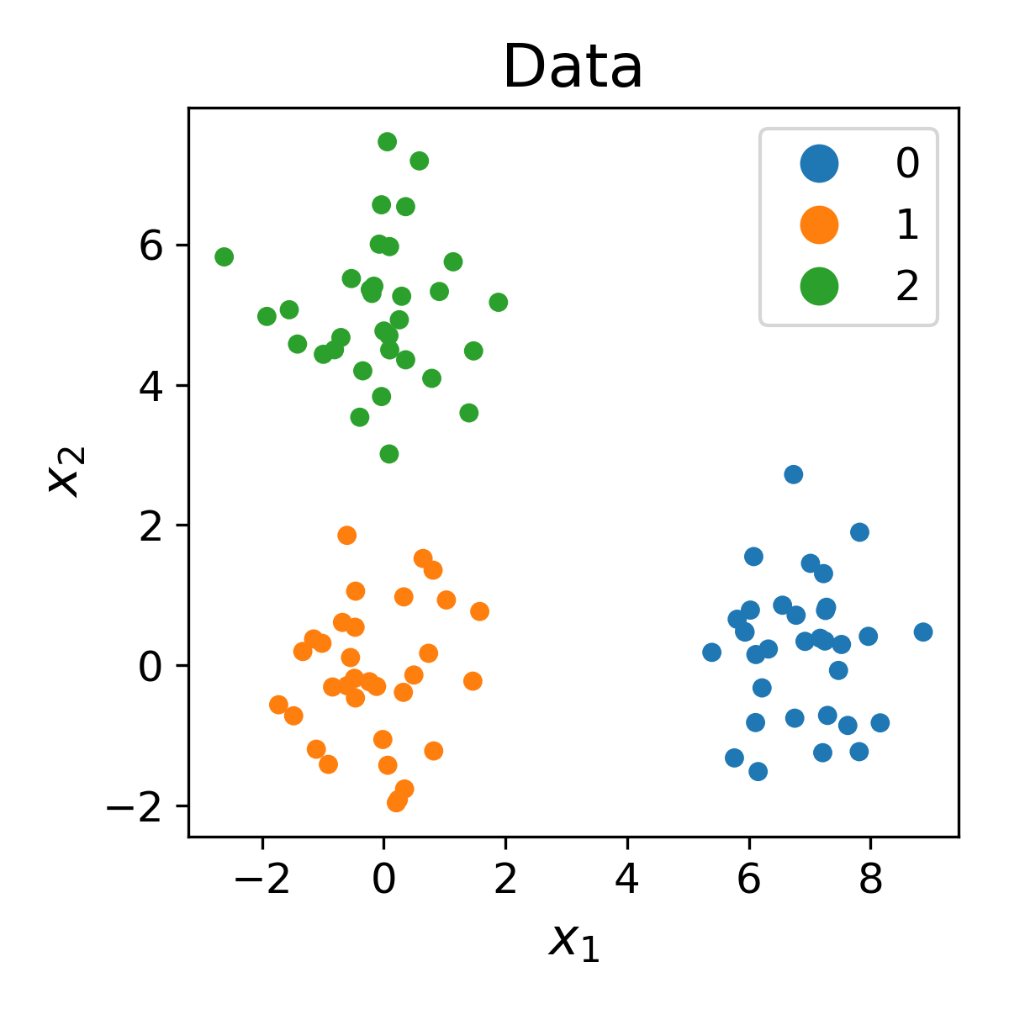
How do we decide the correct number of clusters?

Slide 34
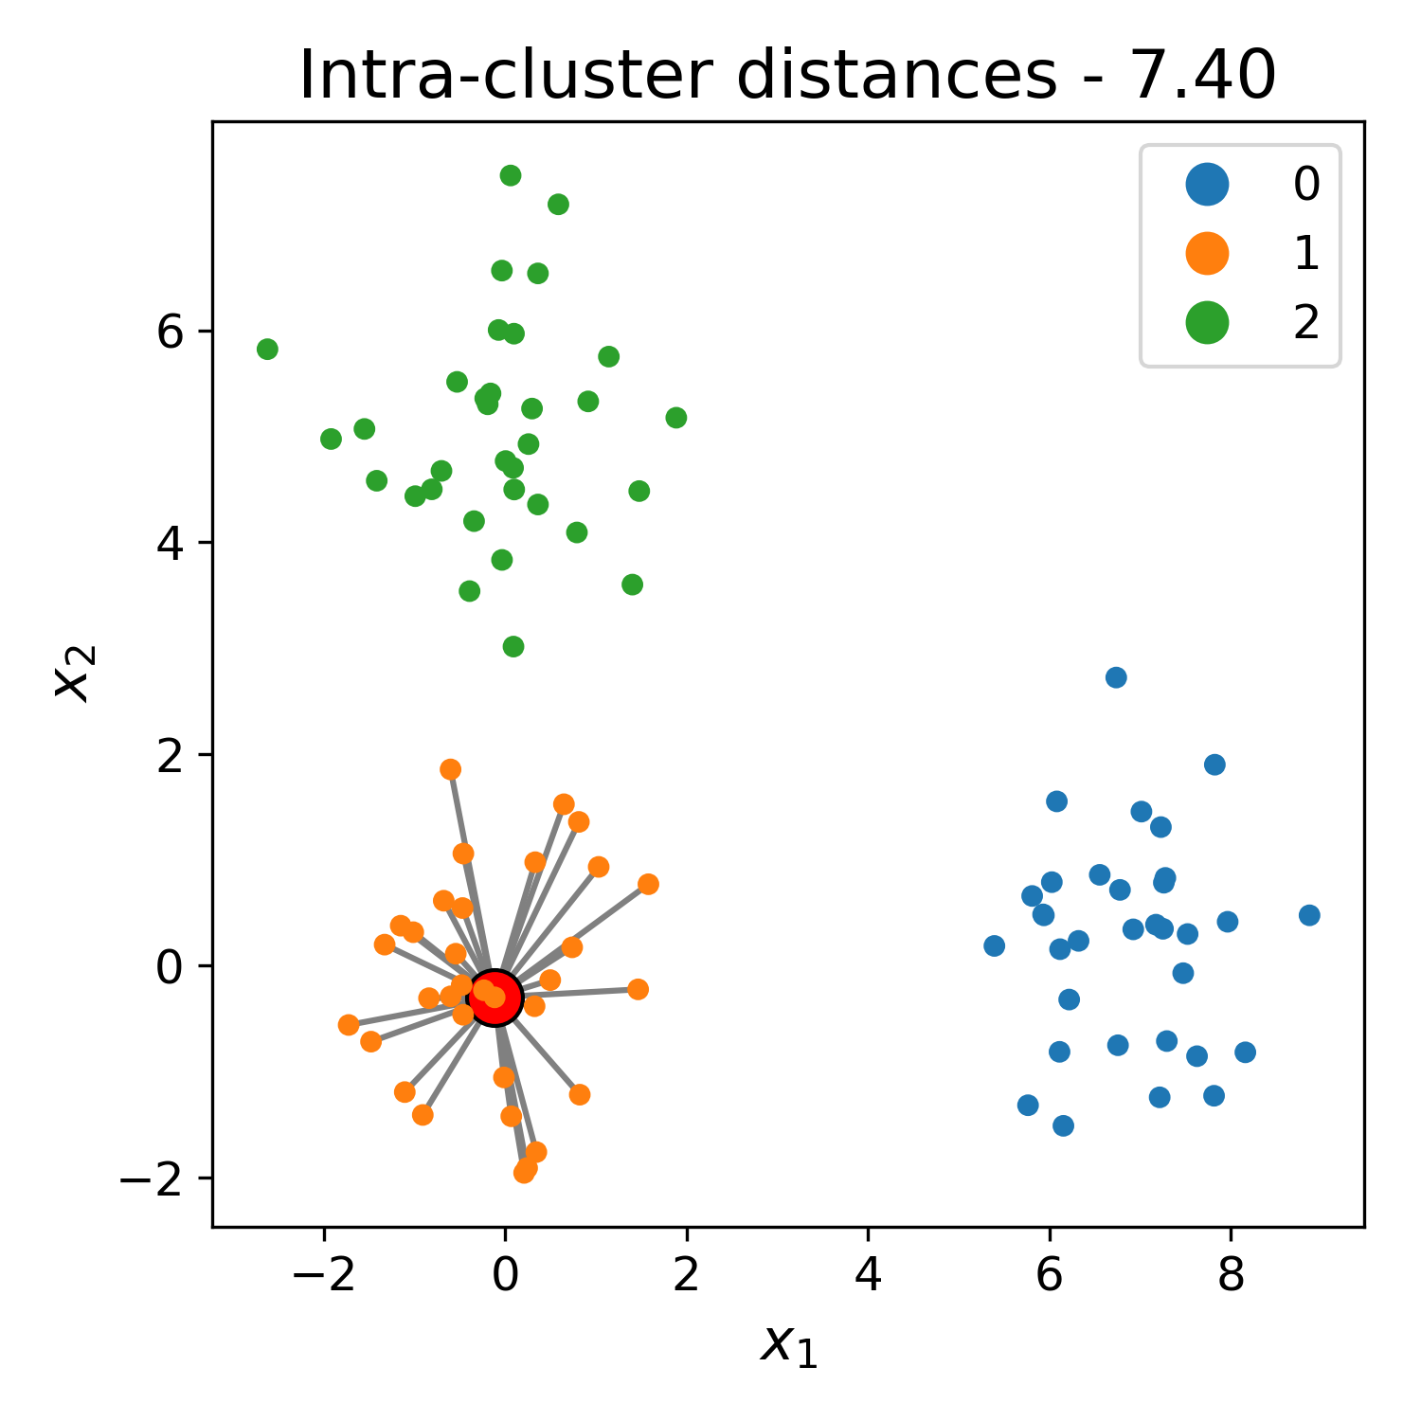
How do we decide the correct number of clusters?

Slide 35
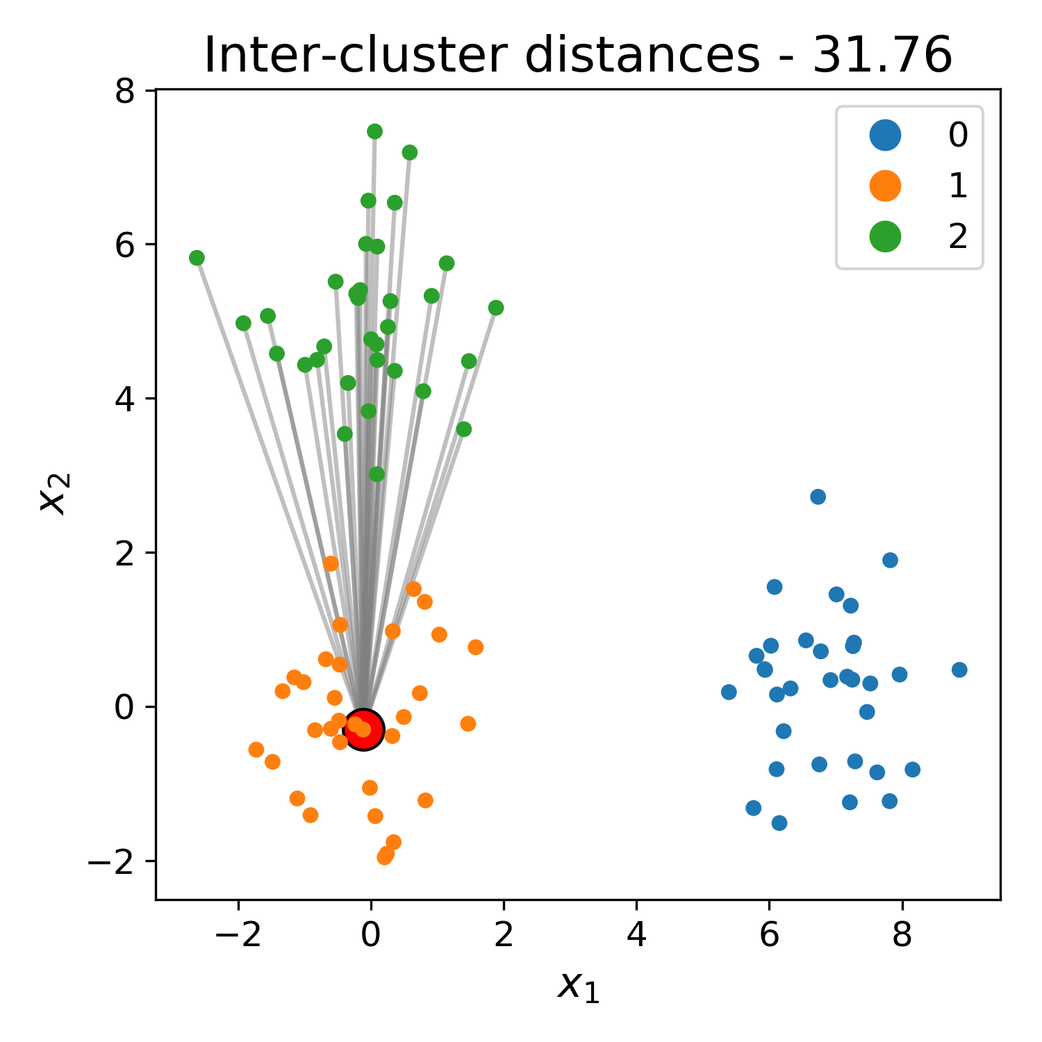
How do we decide the correct number of clusters?

Slide 36
How do we decide the correct number of clusters?
A
B

Slide 37
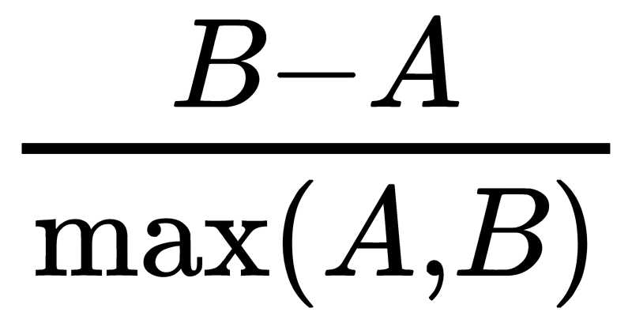
How do we decide the correct number of clusters?
A
B

Slide 38
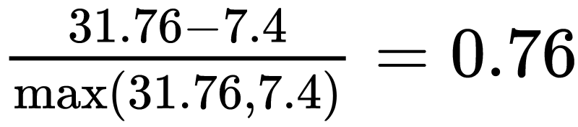
How do we decide the correct number of clusters?
A
B

Slide 39
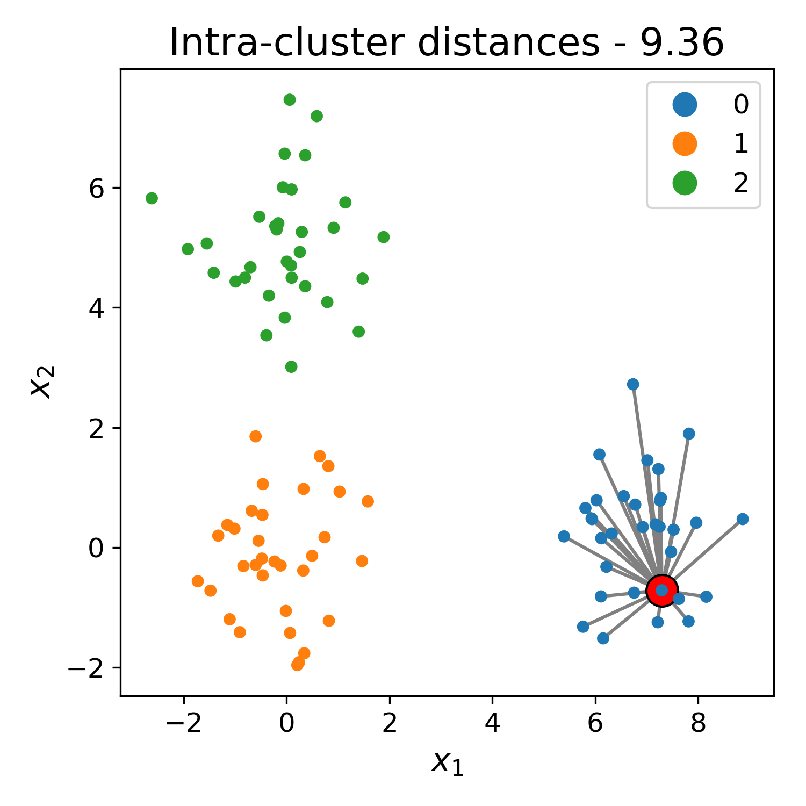
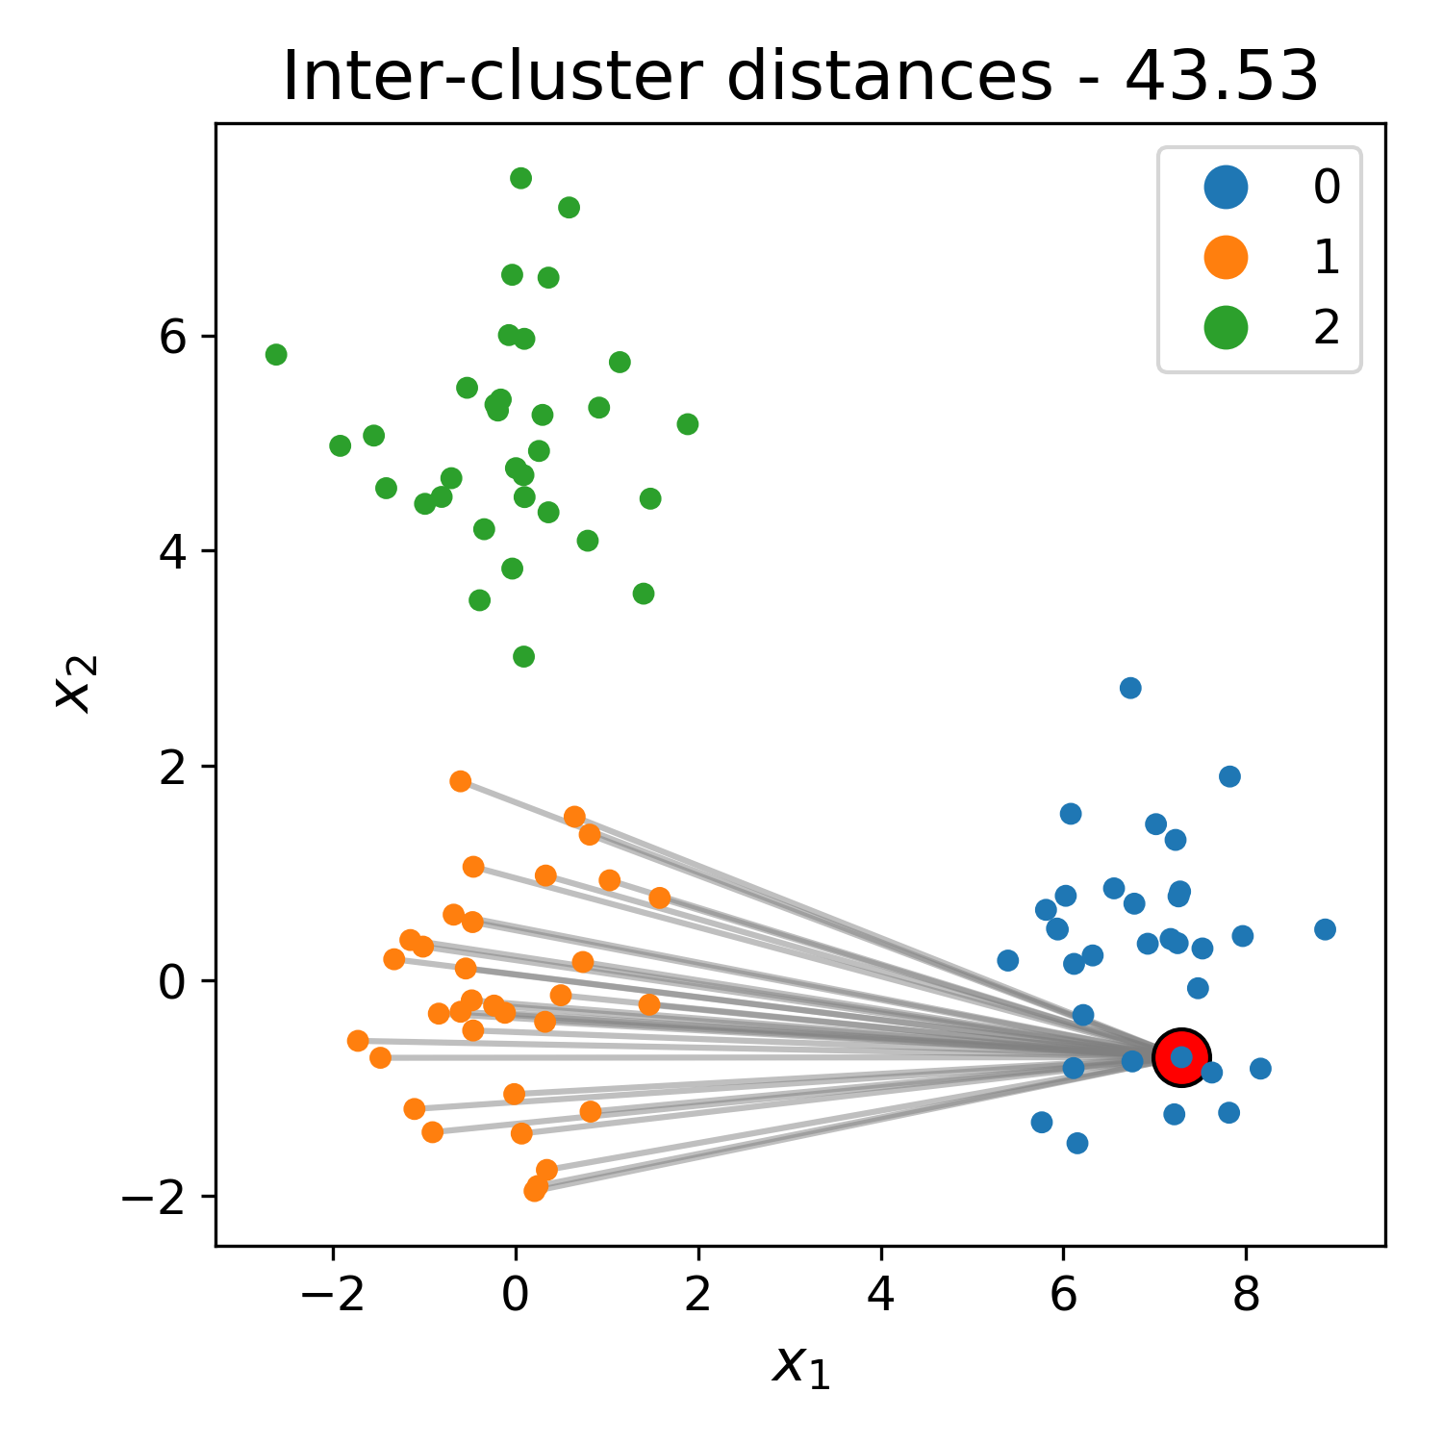
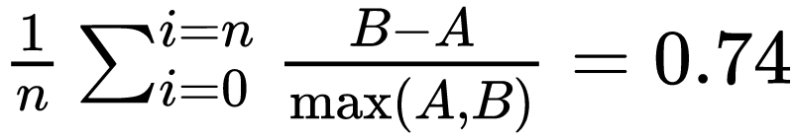
How do we decide the correct number of clusters?
A
B
Silhouette score

Slide 40
Silhouette score is a measure of fit for cluster assignments
The Silhouette Score is calculated using the mean intra-cluster distance (a) and the mean nearest-cluster distance (b) for each sample.
The Silhouette Score for a sample is (b - a) / max(a, b).
The best value is 1 and the worst value is -1. Values near 0 indicate overlapping clusters. Negative values generally indicate that a sample has been assigned to the wrong cluster, as a different cluster is more similar.
https://scikit-learn.org/stable/modules/generated/sklearn.metrics.silhouette_score.html

Slide 41
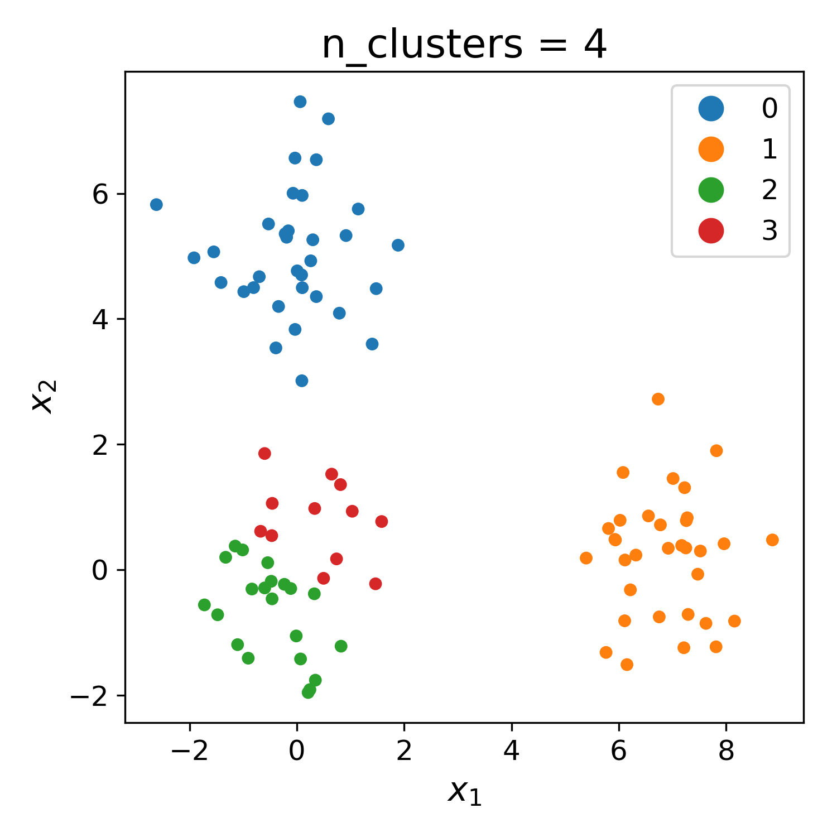
What happens when we change k?

Slide 42
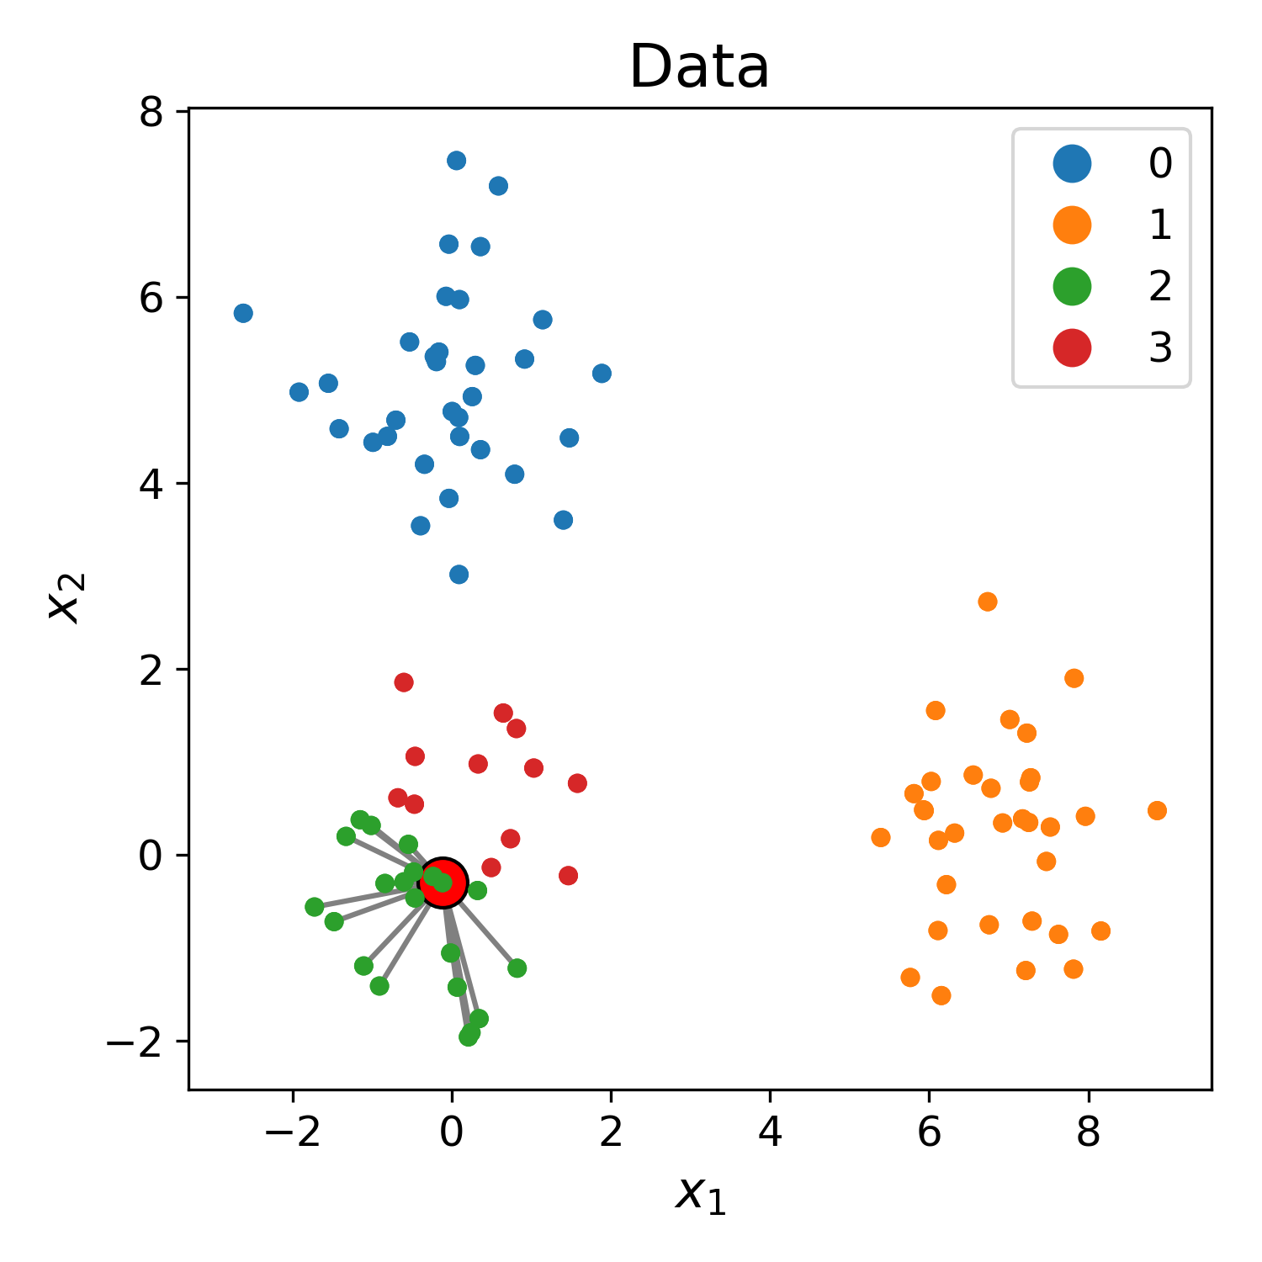
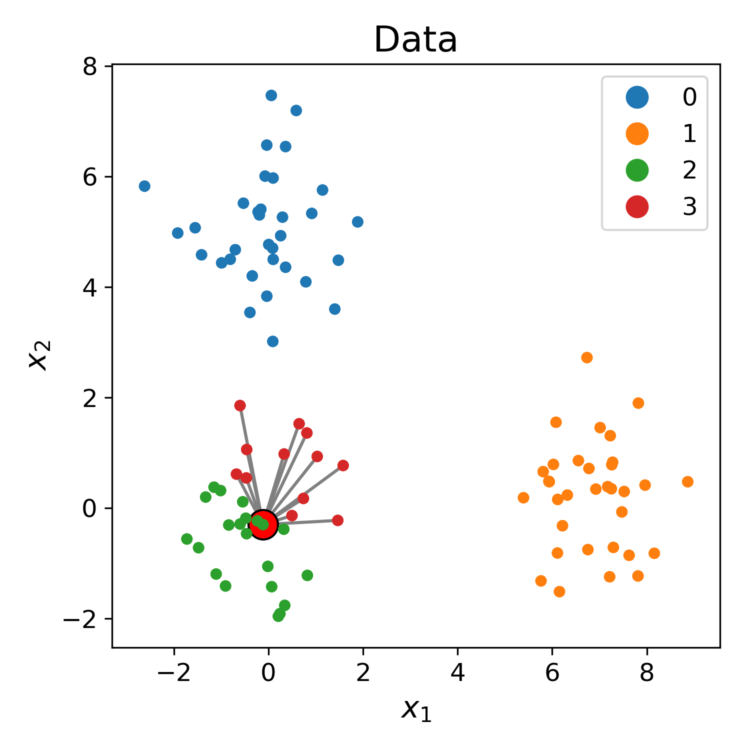
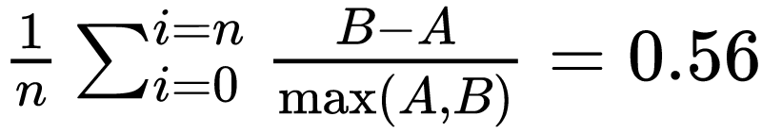
How do we decide the correct number of clusters?
A
B
Silhouette score

Slide 43
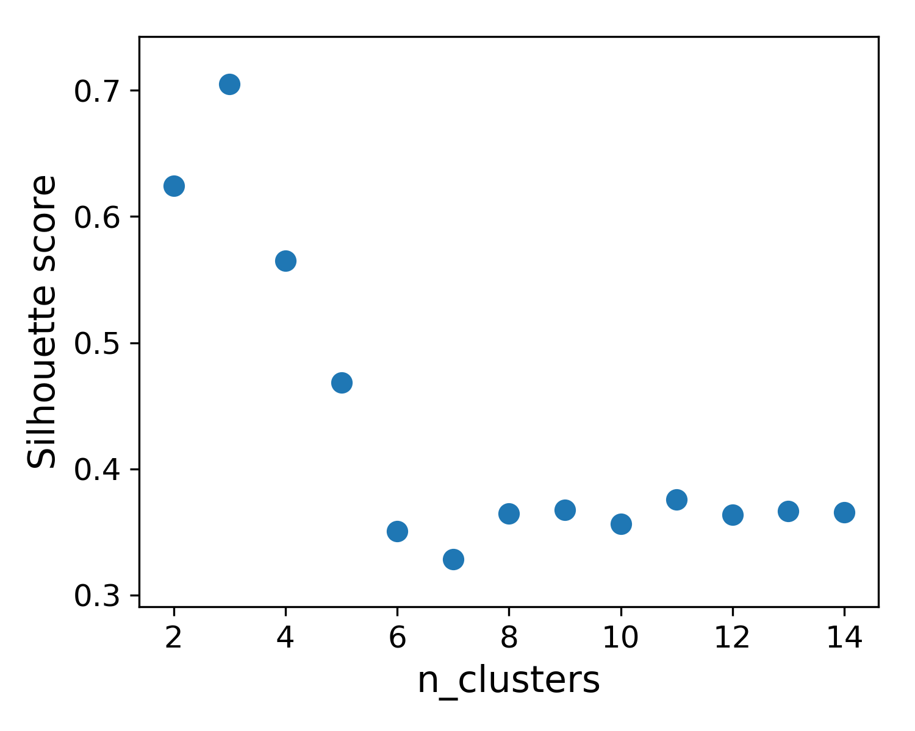
Examining Silhouette score across n_clusters indicates ideal `k`

Slide 44
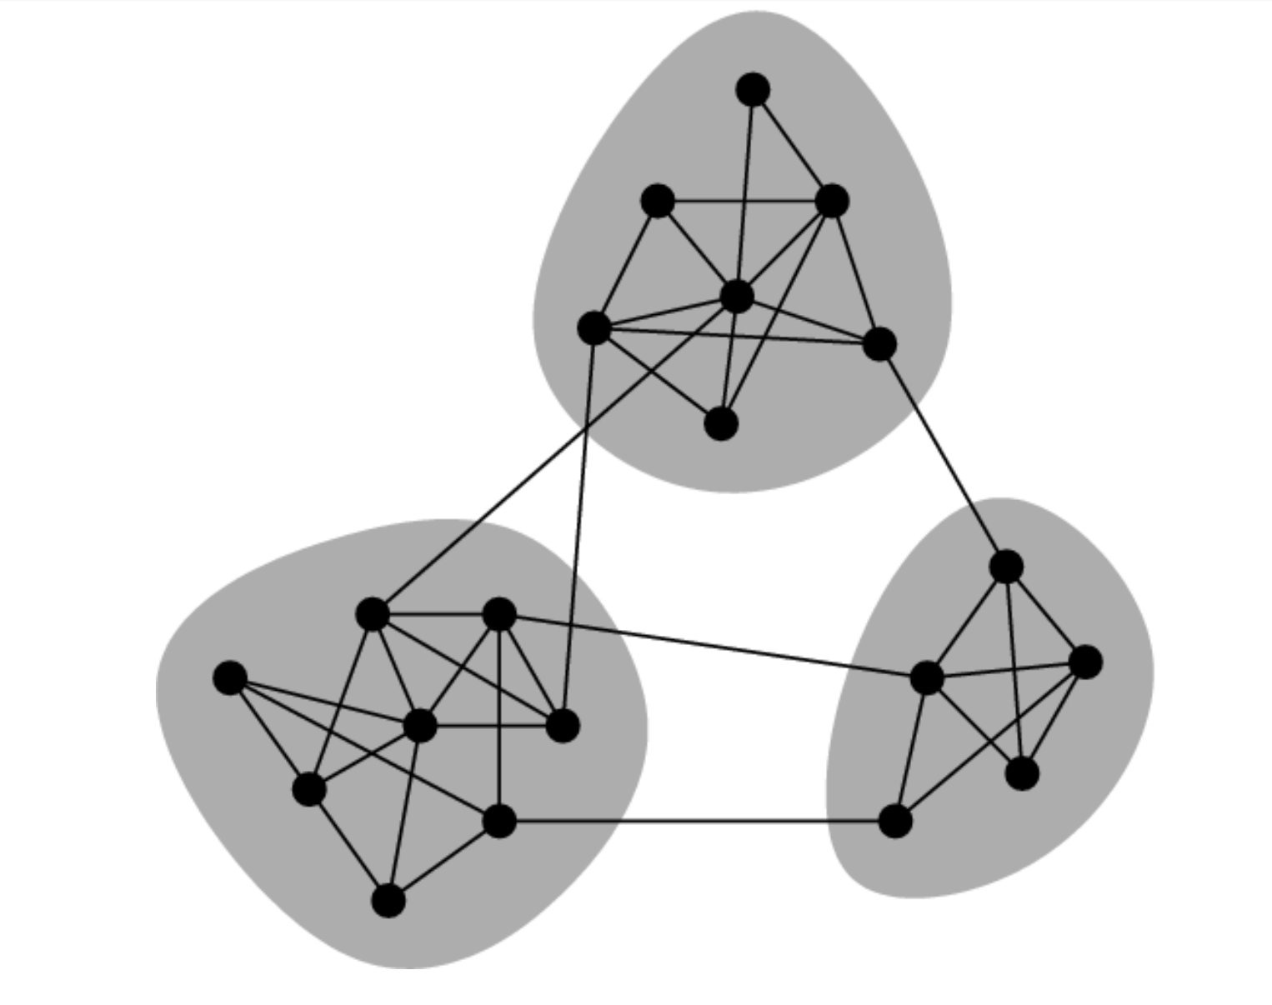
Graph-based Clusters

Slide 45
Recall data represented as graph
Using an adjacency matrix
Distances, Affinities
K-Nearest Neighbors (to sparsify)
Knn naturally obscures density
K-nearest neighbors are not equally far away
Every point choses some neighbors

Slide 46
Neighbors by distance
Pick all nodes of less than distance d as neighbors
What should d be?
May result in a non-sparse graph
Harder to handle
May result in disconnected graph

Slide 47
Agglomerating vs Splitting

Slide 48
Advantage of Hierarchy
Examining different levels of granularity
Fast, each pass has fewer nodes than the previous
Circumvents “resolution limit” problem

Slide 49
Hierarchical Clustering
First level: link neighbors
Link clusters
How do you measure distance between clusters?

Slide 50
Single linkage
Average linkage
Complete Linkage
Min
Mean
Max

Slide 51
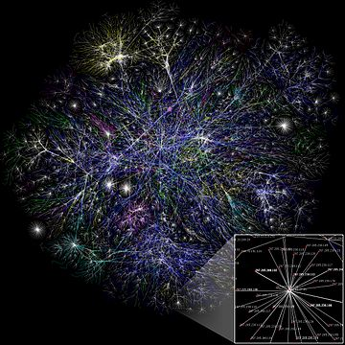
Community Detection

Slide 52
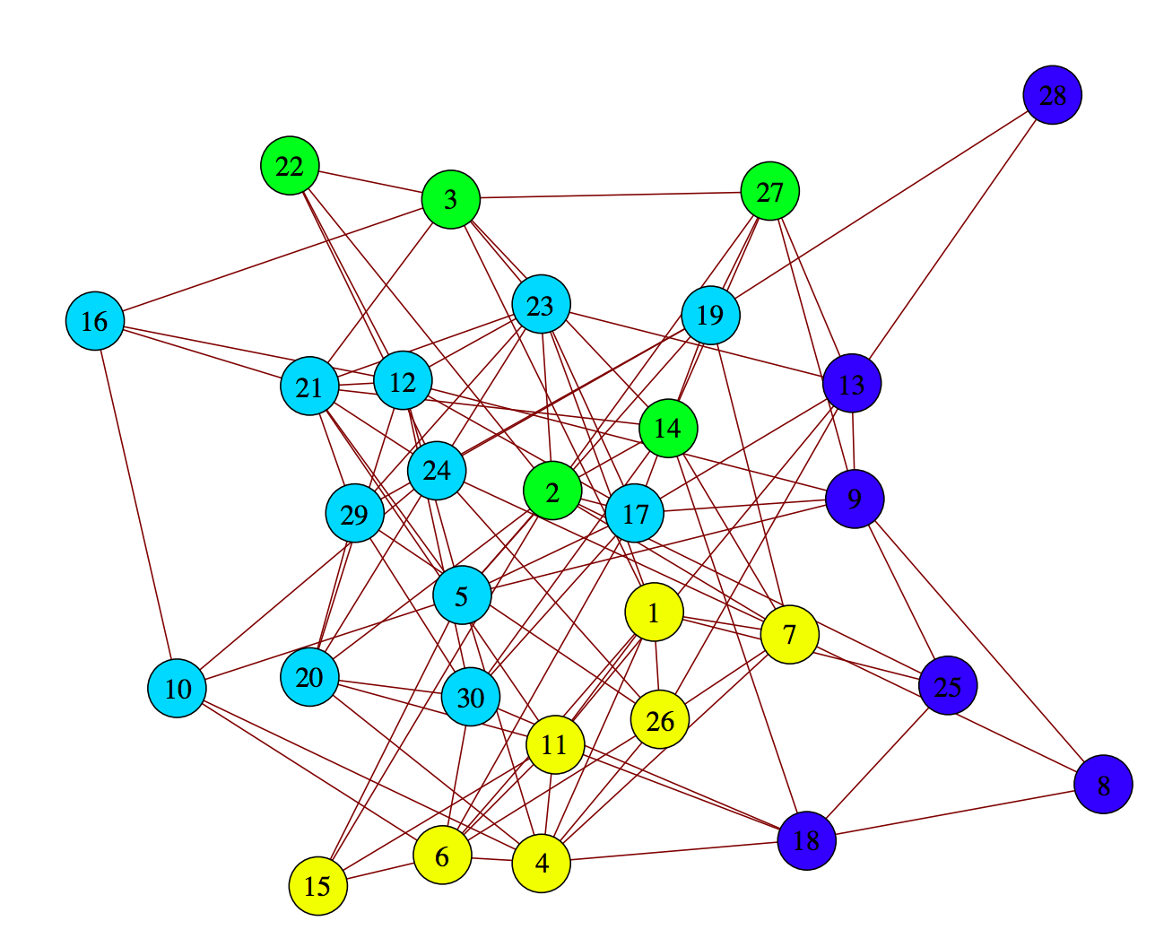
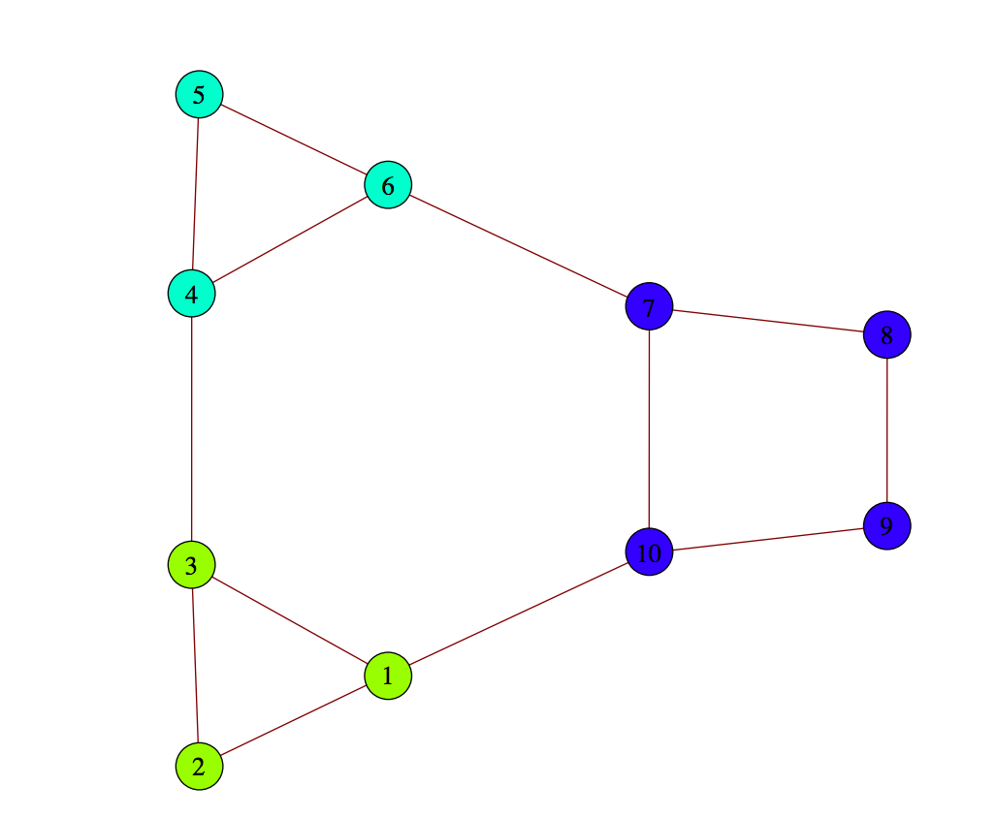
Clustering by “modularity”
Modular Graph
Random Graph
Newman and Girvan (2004)

Slide 53
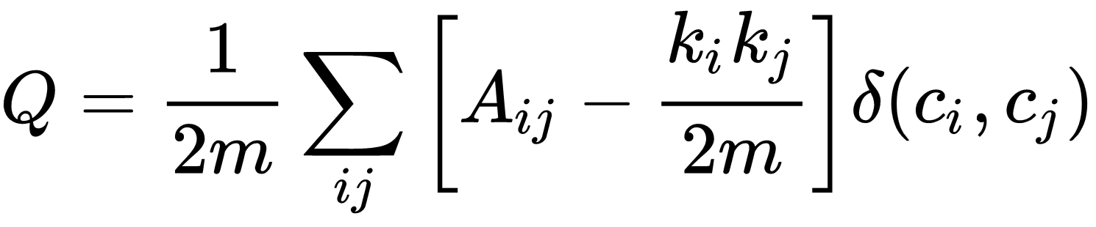
Louvain clustering maximizes modularity of clusters on a graph
Modularity =
m is the sum of all edge weights in the graph
Aij is the edge weight between nodes i and j
ki is the sum of all edges around node i (also called degree)
δ is 1 if i and j are in the same community and 0 otherwise
Notes:
Modularity =

Slide 54
Louvain clustering maximizes modularity of clusters on a graph
constant
Adjusts for # edges per node
Modularity =
m is the sum of all edge weights in the graph
Aij is the edge weight between nodes i and j
ki is the sum of all edges around node i
δ is 1 if i and j are in the same community and 0 otherwise
Notes:
Modularity =

Slide 55
Louvain clustering maximizes modularity of clusters on a graph
Connectivity between nodes
constant
Adjusts for # edges per node
Modularity =
Only consider connections within communities
m is the sum of all edge weights in the graph
Aij is the edge weight between nodes i and j
ki is the sum of all edges around node i
δ is 1 if i and j are in the same community and 0 otherwise
Notes:
Modularity =

Slide 56
Louvain clustering maximizes modularity of clusters on a graph
Connectivity between nodes
constant
Adjusts for # edges per node
Modularity =
Only consider connections within communities
m is the sum of all edge weights in the graph
Aij is the edge weight between nodes i and j
ki is the sum of all edges around node i
δ is 1 if i and j are in the same community and 0 otherwise
1
5
1
5
2
4
2
4
6
6
3
3
Notes:
Ask, who can tell me why we can’t set the number of clusters here?

Slide 57
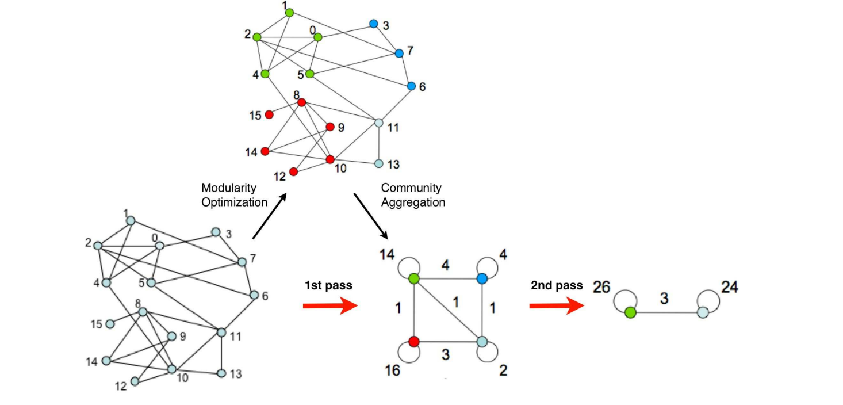
Greedy Modularity Optimization (Newman 2003)
Start with each point in its own cluster
Merge two clusters that would increase modularity by the most
Stop when all merges reduce modularity

Slide 58
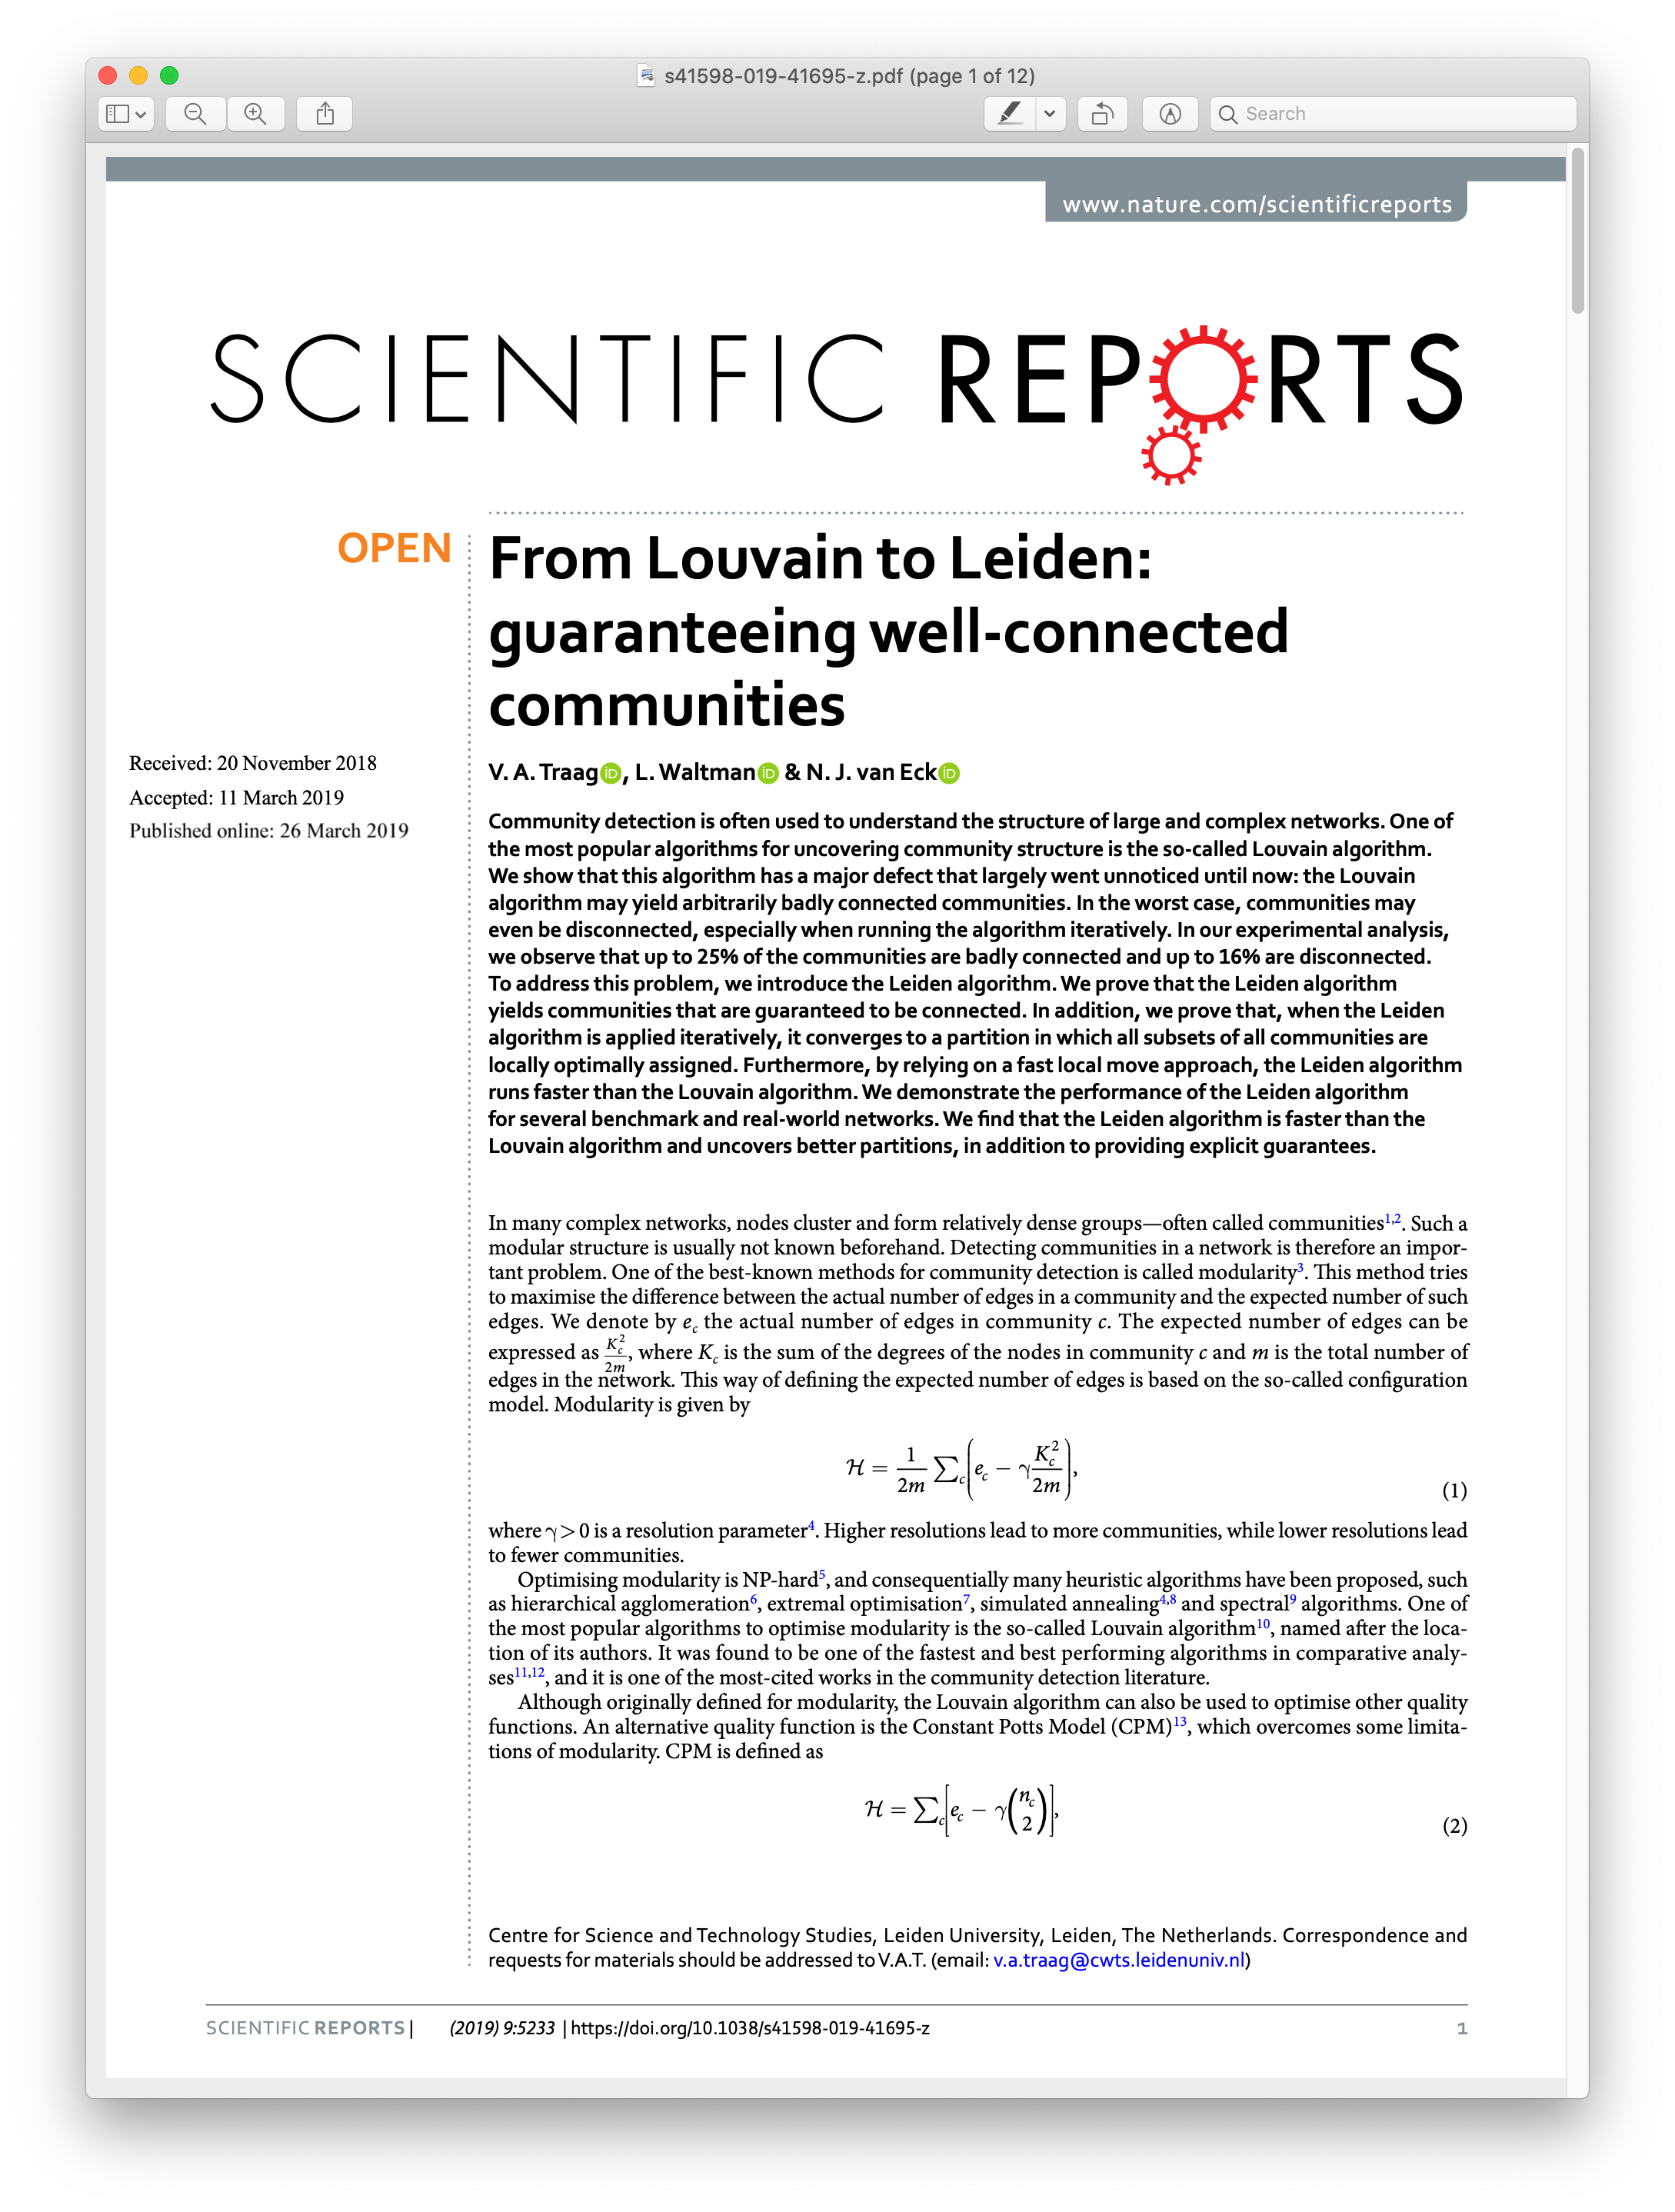
https://www.nature.com/articles/s41598-019-41695-z

Slide 59
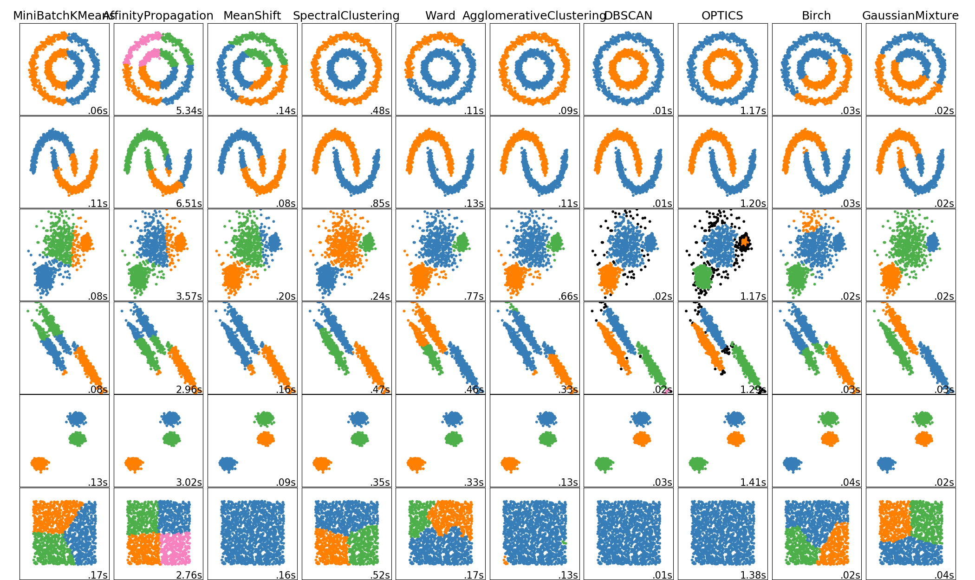
https://scikit-learn.org/stable/modules/clustering.html

Slide 60
Conclusions
Clustering algorithms partition data to identify groups of similar observations
KMeans is an iterative algorithm that minimizes within-cluster distances in the data space
Spectral clustering minimizes within-cluster distances using eigenvectors of the laplacian
Louvain / Leiden iteratively aggregate clusters on a graph to increase a modularity heuristic

Slide 61
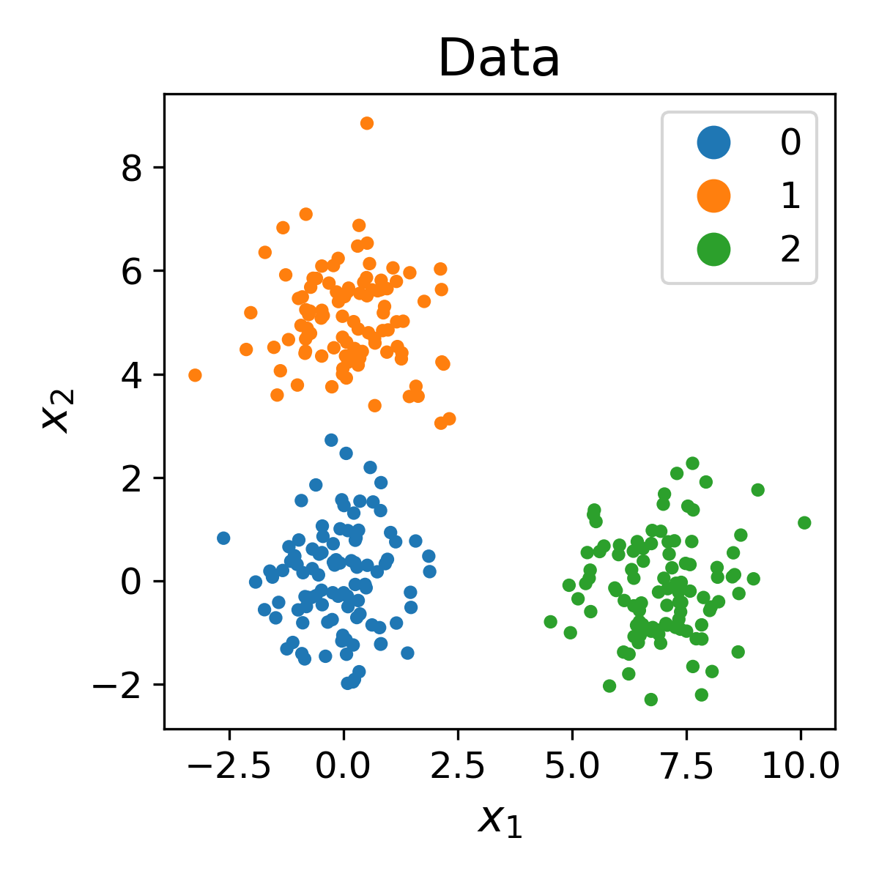
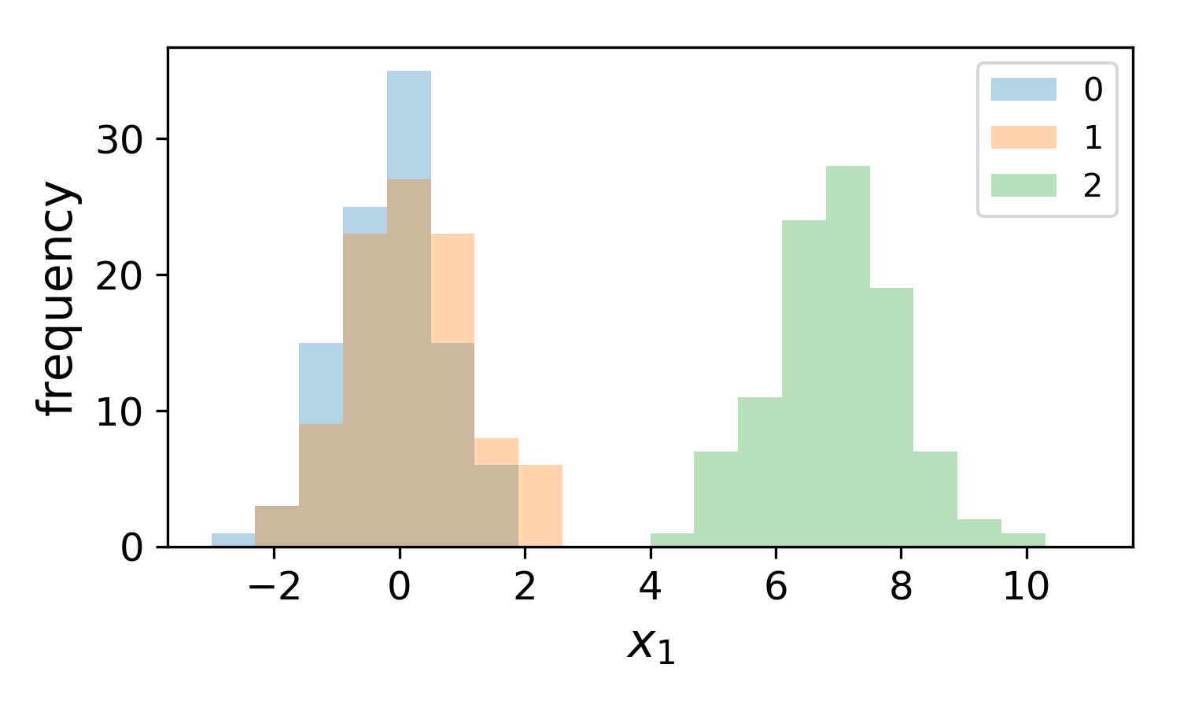

How can we identify differentially expressed genes between clusters?

Slide 62

The t-test determines if two distributions have non-equal means

Slide 63
The t-test determines if two Gaussian distributions have non-equal means

Slide 64


What if the data isn’t normally distributed?
x3 = [2,2,3,4,5,5,5,20]
x3 = [2,2,3,7,9,10,11,16]
ranks = [1,1,3,4,5,6 , 7, 8]
rank1 = [1,2,4,5]
rank2 = [3,6,7,8]
R1_sum = 12
R2_sum = 24

Slide 65

Once we have the U-statistic, we consult a significance table

Slide 66
Assumptions of each test
T-test
All the observations from both groups are independent of each other
The responses are ordinal (can be placed on a number line)
The data is normally distributed (follows a Gaussian distribution)
Under the null hypothesis H0, the distributions of both populations are equal
The alternative hypothesis H1 is that the distributions are not equal
Mann-Whitney U Test (aka Wilcoxon rank-sum)
All the observations from both groups are independent of each other
The responses are ordinal (can be placed on a number line)
Under the null hypothesis H0, the distributions of both populations are equal
The alternative hypothesis H1 is that the distributions are not equal

Slide 67
Assumptions of each test
T-test
All the observations from both groups are independent of each other
The responses are ordinal (can be placed on a number line)
The data is normally distributed (follows a Gaussian distribution)
Under the null hypothesis H0, the distributions of both populations are equal
The alternative hypothesis H1 is that the distributions are not equal
Mann-Whitney U Test (aka Wilcoxon rank-sum)
All the observations from both groups are independent of each other
The responses are ordinal (can be placed on a number line)
Under the null hypothesis H0, the distributions of both populations are equal
The alternative hypothesis H1 is that the distributions are not equal

Slide 68

Distributions of expression values are not independent after clustering
Zhang, J. et al. Cell Systems. 2019. doi.org/10.1016/j.cels.2019.07.012

Slide 69
Distributions of expression values are not independent after clustering
Don’t trust p-values when doing differential expression!
Zhang, J. et al. Cell Systems. 2019. doi.org/10.1016/j.cels.2019.07.012

Slide 70
How do we infer continuous changes in cell state from single cells?
Notes:
TA introduction
Talk about not teaching code (not a programming workshop)

Slide 71

A simple developmental system
State 1
Intermediate
State 2
Dimension 1: “Genes that change from State 1 to State 2”
Dimension 2: “Noise genes”

Slide 72
A simple developmental system
State 1
Intermediate
State 2
Things we might like to know:
What genes are expressed in each population?
What genes change the most from State 1 -> State 2?
What is the ordering of gene expression?
How do gene-gene relationships change across states?

Slide 73



A simple developmental system
State 1
Intermediate
State 2
Sample at
1, 2, 3 days
+
Cells
Growth
Factor
1d
2d
3d

Slide 74
A simple developmental system
State 1
Intermediate
State 2
Sample at
1, 2, 3 days
+
Cells
Growth
Factor
1d
2d
3d

Slide 75

We must infer underlying biology from experimental observations
State 1
Underlying biology
Intermediate
State 2
Day 1
Experimental
data
Day 2
Day 3

Slide 76

The goal of trajectory inference (TI) is to infer a temporal ordering of cells
Summary of 45 TI methods
dynverse.org

Slide 77


Learning pseudotime via graph walks

Slide 78









Graph walks approximate manifold distances
Shortest path between points
$$a_{1}$$
$$a_{0}$$
$$a_{1}$$
$$a_{2}$$
$$a_{2}$$
$d_{geodesic}\left(a_{1},a_{2}\right)=shortestpath(a_{1},a_{2}$)
$$=5$$

Slide 79

Learning pseudotime via graph walks

Slide 80

Note: you do not need multiple time points for pseudotime analysis
Expression of differentiation marker

Slide 81





Diffusion pseudotime – from graph distance to random walks
Euclidean distance between two vectors
Sum over values of t
$ψ$ is used for eigenvectors
$ψ_{0}$ represents starting probabilities for T
Provides a calculatable solution to the infinite series
T is the random walk matrix
$I$ is the identity matrix with 1’s on the diagonal
$$\left[\begin{matrix}1 & ⋯ & 0 \\ ⋮ & ⋱ & ⋮ \\ 0 & ⋯ & 1\end{matrix}\right]$$

Slide 82

Diffusion pseudotime – from graph distance to random walks
Euclidean distance between two vectors
Sum over values of t
Transition probabilities give data geometry
Provides a calculatable solution to the infinite series
Correlation reveals branches

Slide 83


Using DPT to detect branches
User-defined root cell

Slide 84

Using DPT to detect branches
Maximally distant cell

Slide 85

Using DPT to detect branches
DPT(root , x)
DPT(end , x)
“Forward pseudotime”
“Backward pseudotime”

Slide 86

Using DPT to detect branches
DPT(root , x)
DPT(end , x)
Cells on the same “branch” as the root and end cell have negative DPT correlation.
Cells on different branches have positive DPT correlation
“Forward pseudotime”
“Backward pseudotime”

Slide 87



Pseudotime facilitates analysis of genes driving cellular progression
Ordering
Sample
Pseudotime
(graph walk)
Ground truth

Slide 88
Pseudotime facilitates analysis of genes driving cellular progression
Ordering
Sample
Pseudotime
(graph walk)
Ground truth

Slide 89
Pseudotime facilitates analysis of genes driving cellular progression
Ordering
Sample
Pseudotime
(graph walk)
Ground truth

Slide 90

Principal curves – non-linear PCA
Linear Regression
PCA
Non-linear Regression
Principal Curves
Hastie and Stuetzle, 1989

Slide 91

Slingshot - Street et al. 2018
2. Cluster &
Minimum Spanning Tree
1. Dimension-reduced data
3. Fit principal curves
4. Project data onto principal curves

Slide 92

RNA Velocity: using gene splicing genes to infer future cell state
Le Manno, et al. Nature. 2018.

Slide 93
RNA Velocity: using gene splicing genes to infer future cell state
Le Manno, et al. Nature. 2018.

Slide 94
RNA velocity correctly infers circadian rhythm in mouse liver
mRNA was measured in bulk over 24 hours in the mouse liver

Slide 95

Neural fate decisions in the mouse hippocampus
CA3
Subiculum
CA1
Neuroblast
Granule
Radial
glia
nIPC
Astrocyte
OPC

Slide 96
Neural fate decisions in the mouse hippocampus
CA3
Subiculum
CA1
Neuroblast
Granule
Radial
glia
nIPC
Astrocyte
OPC

Slide 97
Conclusions
Pseudotime identifies an ordering of cells that match the developmental progression of gene expression
Pseudotime can be identified from a single timepoint
Methods for inferring pseudotime use graph walks or identify axes through the data
A comprehensive comparison of trajectory inference methods is available as dynverse.org

Slide 98
Learning gene-gene relationships
Notes:
TA introduction
Talk about not teaching code (not a programming workshop)

Slide 99
Single Cell Data
Each cell provides evidence for shape of
relationship between two genes
Gene Y
Gene X

Slide 100

Gene-gene Relationships
Gene X
Gene Z
Gene W
Gene Y

Slide 101

Notes:
How do you know that the second pair might have a relationship (interacting, coregulatory), but not the first?
https://www.polleverywhere.com/free_text_polls/bLQQ1gVePMZVkVhyxhWEf

Slide 102

Intuition Behind Relationships
When X changes Y should change
Does the change have to be proportional?
Does the change have to be in the same direction?
No

Slide 103
Correlation as a measure
Problem: checks only for linear relationships

Slide 104


Information Theory
“ A Mathematical Theory of Communication”

Slide 105
Mutual Information: Shape Agnostic
Mutual information is a metric that comes from information theory
Do. two variables have “information” on each other?
Information is defined as the opposite of uncertainty
If a variable X has information on another variable Y then knowing X reduces the uncertainty of Y

Slide 106
Uncertainty measured by entropy
Wide flat distributions have high entropy
Peaky narrow ones have low entropy

Slide 107
Uniform has highest entropy

Slide 108

Entropy Measured in Bits
Fair coin has 1 bit of information
P(heads) = ½ , P(heads) = ½
H(coin) = -(½) log(½) –(½)log(½) = 1

Slide 109
Entropy Properties
Maximum at uniform distribution – because here each outcome is equally likely
Symmetric with respect to probabilities – flipping probabilities of events should not change information
Continuous – small change in probabilities should result in small change in entropy
Additive – Independent sources of information should add

Slide 110

Entropy
Y Spread
in X-Slice
Y Spread
X-Slice
Notes:
At its core mutual information determines how the spread of a variable Y decreases as you condition on another variables X. But mutual information works when there is an even samplign along the dynamic range.

Slide 111
Conditional Entropy
Y Spread
In X-Slice
H(Y|X)<= H(Y)
X-Slice
Measure of Uncertainty in a random variable
given knowledge about another variable
Notes:
At its core mutual information determines how the spread of a variable Y decreases as you condition on another variables X. But mutual information works when there is an even samplign along the dynamic range.

Slide 112
Mutual Information
Y Spread
in X-Slice
Y Spread
X-Slice
Mutual Information: I(X,Y) = H(Y) –H(Y|X)
Notes:
At its core mutual information determines how the spread of a variable Y decreases as you condition on another variables X. But mutual information works when there is an even samplign along the dynamic range.

Slide 113
Trends with High and Low MI
Low MI
High MI
Notes:
MI is a good metric, but it does not work for the same reason that density estimates do not work. It is “distracted” by the round dense spot in the data. Change the line from sigmoid

Slide 114

Another Definition
Compares joint to marginal distributions
Equivalent definitions

Slide 115

Computing MI (X->Y) in Data
Step 1: Compute probability density P(Y) – Divide the data into bins and compute probability of datapoint falling into the bin
Y
X

Slide 116

Density estimation
Computing a probability density from data is called density estimation
Kernel density estimation is a popular approach
KNN based density estimation often done on data with affinity graph structure

Slide 117
Computing MI (X->Y) in Data
Step 2: Compute entropy of Y (based on the Y bins)
Y
H(Y)
X

Slide 118
Computing MI (X->Y) in Data
Step 3: Compute entropy in each X column
Y
H(Y|X=1)

Slide 119
Computing MI (X->Y) in Data
Step 3: Compute H(Y) – Sum(_{x}(H(Y|X))*p(x))
Y
H(Y|X=1)

Slide 120

Properties of Mutual Information
I(X;Y)>=0
Data processing inequality:
I(X;Z)<=I(Y;Z)
Conditioning on a third variable can increase or decrease MI between two variables
Why?

Slide 121



Imbalanced Data a Problem for MI
MI will just look at the dense blob
for its computation and not the whole
relationship

Slide 122
Density Resampled Estimate of Mutual Information (DREMI)
Cells in lowly populated parts of relationship useful for unveiling shape and structure

Slide 123

DREMI computes MI off of a Conditional Entropy
H(Y|X)-H(Y|X|X)

Slide 124

scRNA-seq data
regulatory network
Using “snapshot” scRNA-seq data to predict transcription factor-target interactions involved in the epithelial—mesenchymal transition.
Notes:
One of the major goals of my thesis project: to infer regulatory networks from single-cell RNA-seq data
To put this into biological context…I have been working on

Slide 125

MAGIC Helps DREMI

Slide 126

Data after MAGIC
Density estimation
DREMI
Gene Y
Gene X
low
high
quantifying gene-gene relationships
Notes:
The density estimate is intended to smooth and fill in gaps in the data distribution and therefore requires a finer scale of resolution.
The mutual information can be computed at a coarser scale to find clear and strong relationships, reduces noise.
(use on the order of 20 partitions in both the X and the Y directions) and accumulate the density estimates for each grid point in the partition to obtain the coarser joint density distribution on which to compute entropy

Slide 127

Ranking genes by association with pseudotime identifies drivers of differentiation
Cells ordered by pseudotime

Slide 129
Conclusions
Mutual information (MI) can be used to identify non-linear relationships between variables
Density normalization allows for quantifying MI in regions of data sparsity
MI can quantify gene-gene relationships to infer regulatory relationships
MI of genes with pseudotime identifies drivers of differentiation

Slide 130


For tomorrow: Ch. 1 & 2
(Beginner)
(Advanced)
http://neuralnetworksanddeeplearning.com/
https://www.deeplearningbook.org/

Slide 131

Team programming
#2020-workshop-group-help
Noun project

